Slide 1
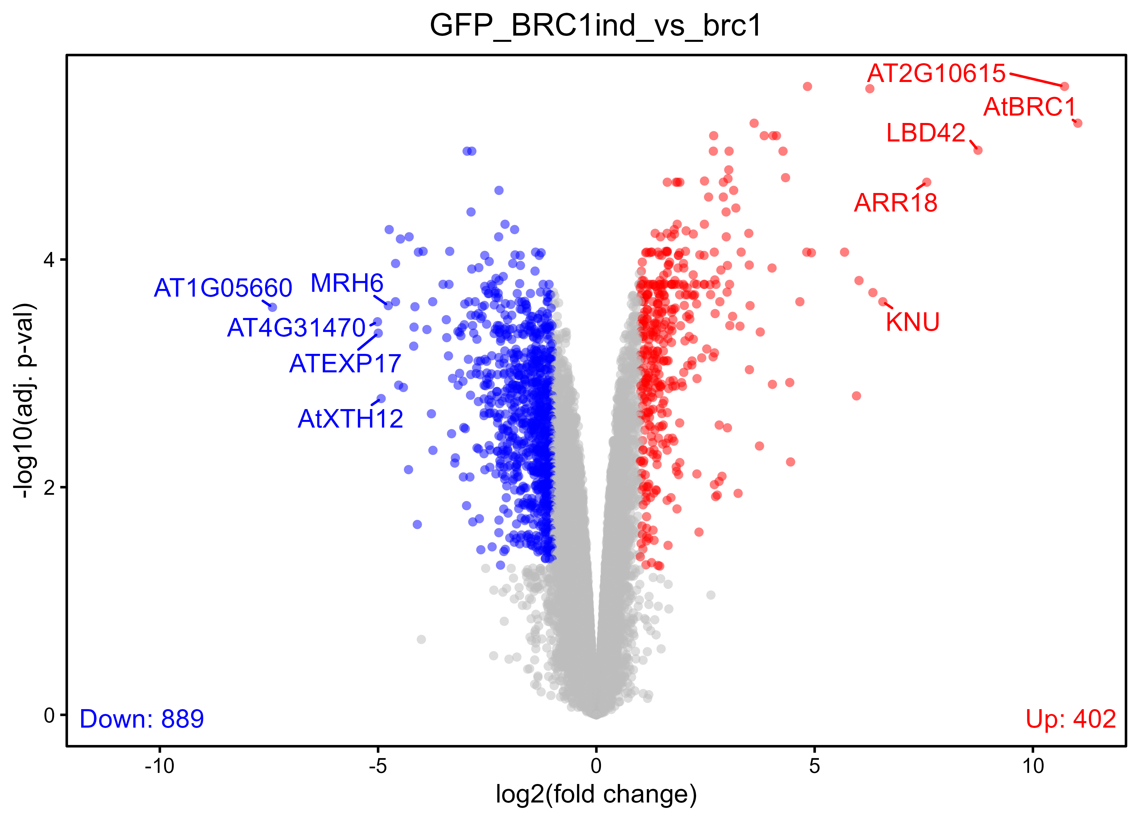
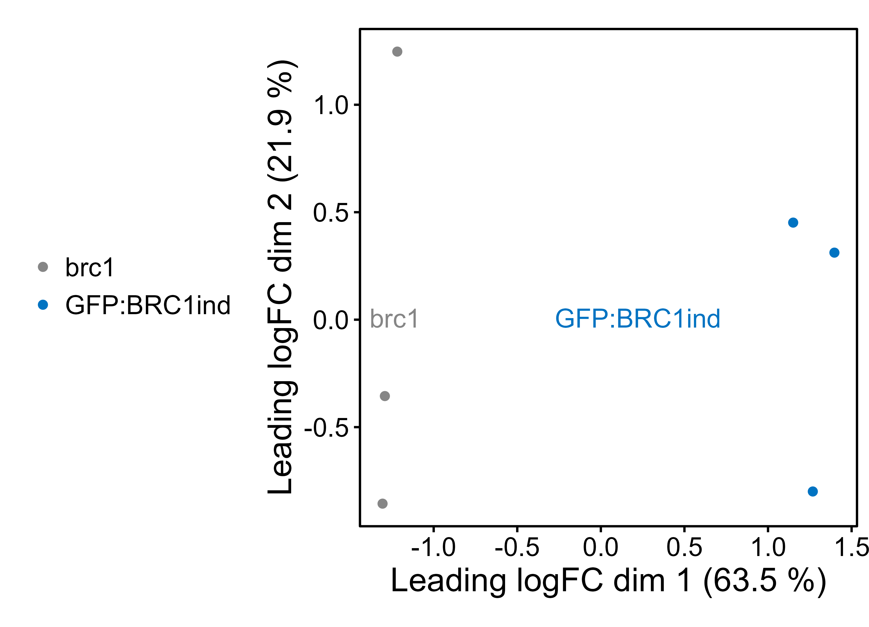
Quality check and data exploration (GFP:BRC1ind)

Slide 2


Quality check and data exploration (GFP:BRC1ind) – filtered fastq

Slide 3
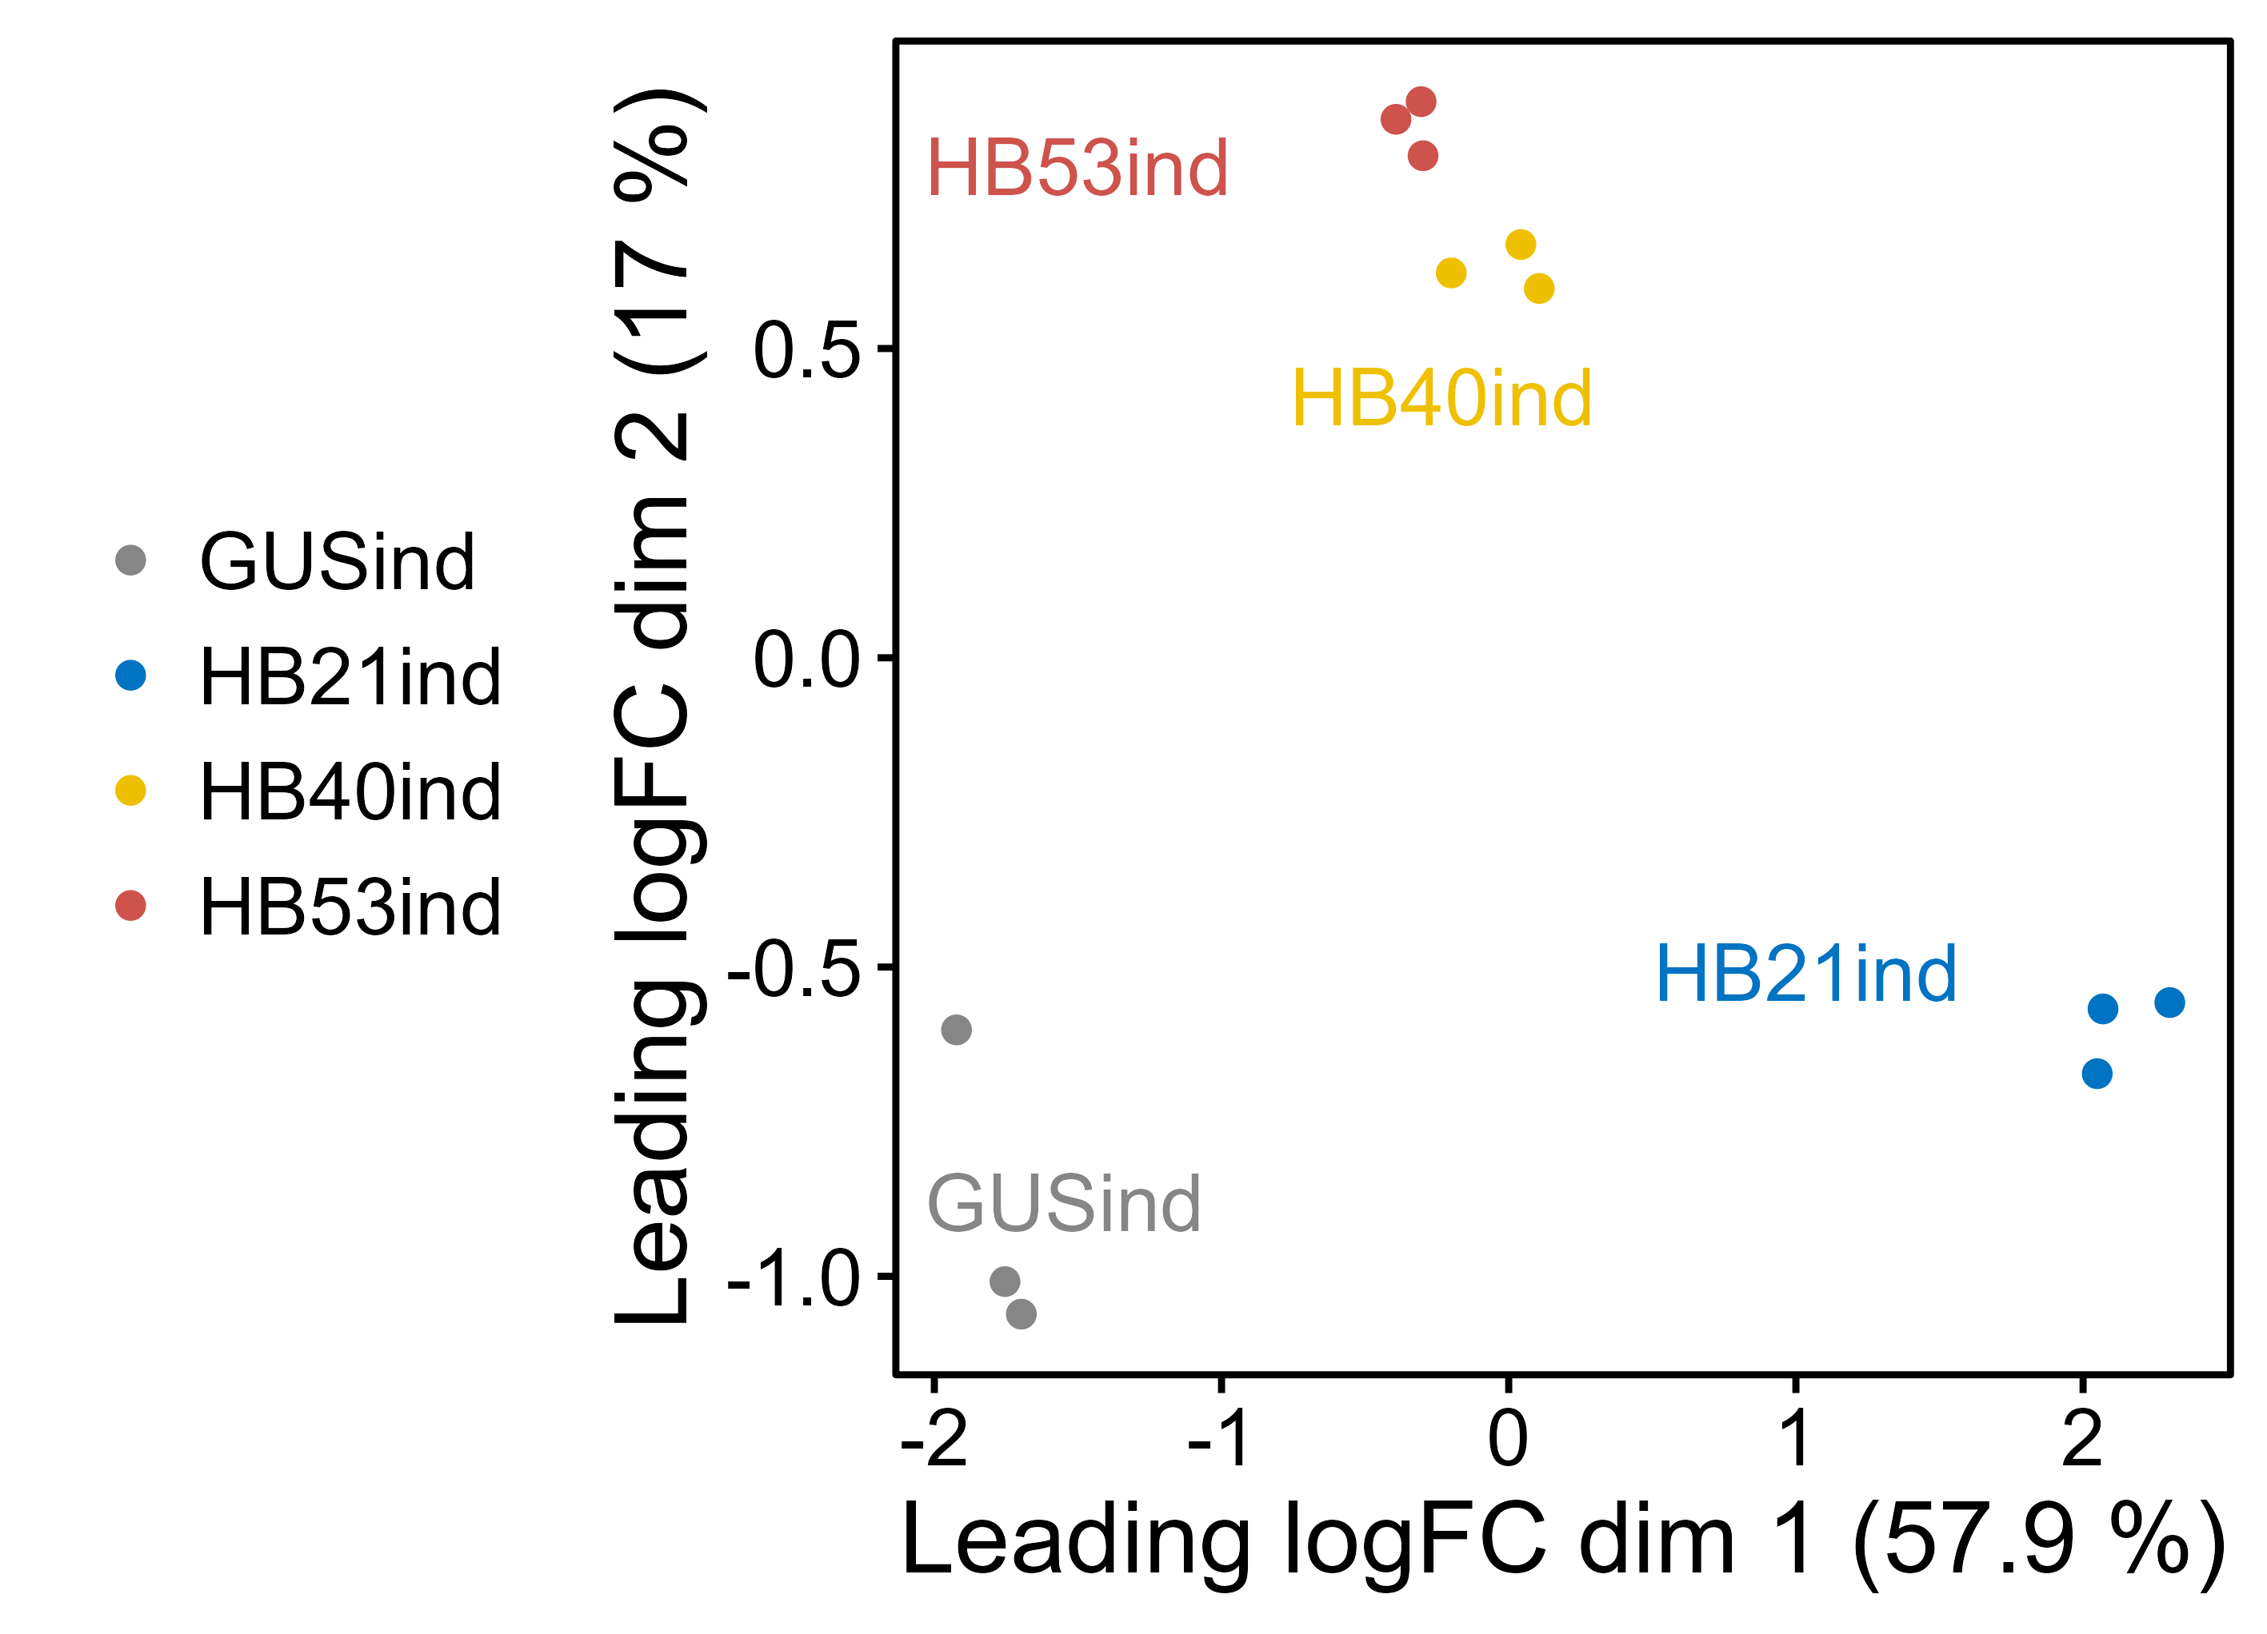
Quality check and data exploration (HBind)

Slide 4

Quality check and data exploration (HBind ) – filtered fastq

Slide 5
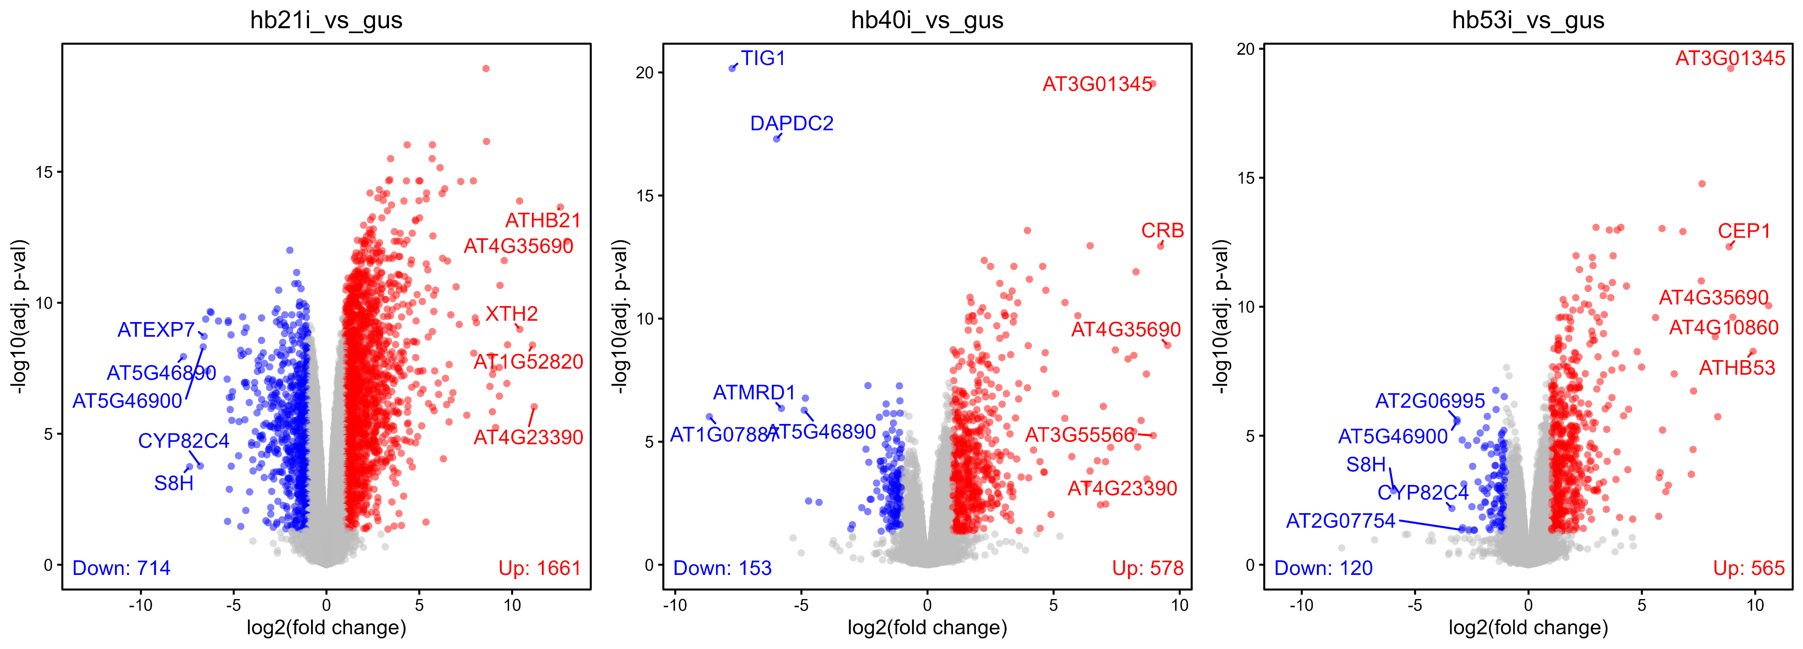
Quality check and data exploration (HBind)

Slide 6
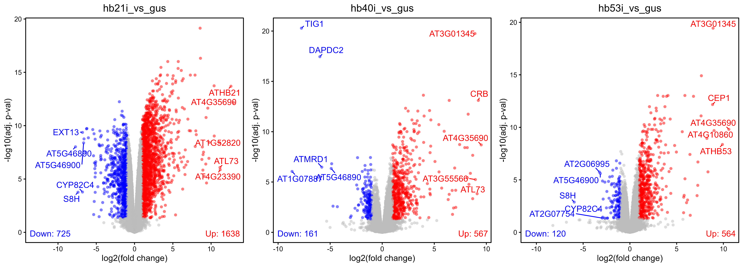
Quality check and data exploration (HBind ) – filtered fastq

Slide 7
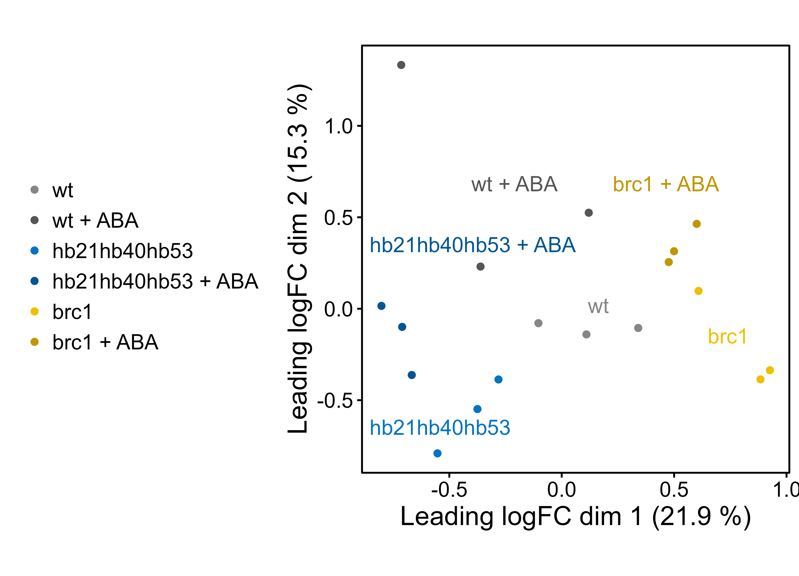
Quality check and data exploration (ABA experiment)

Slide 8
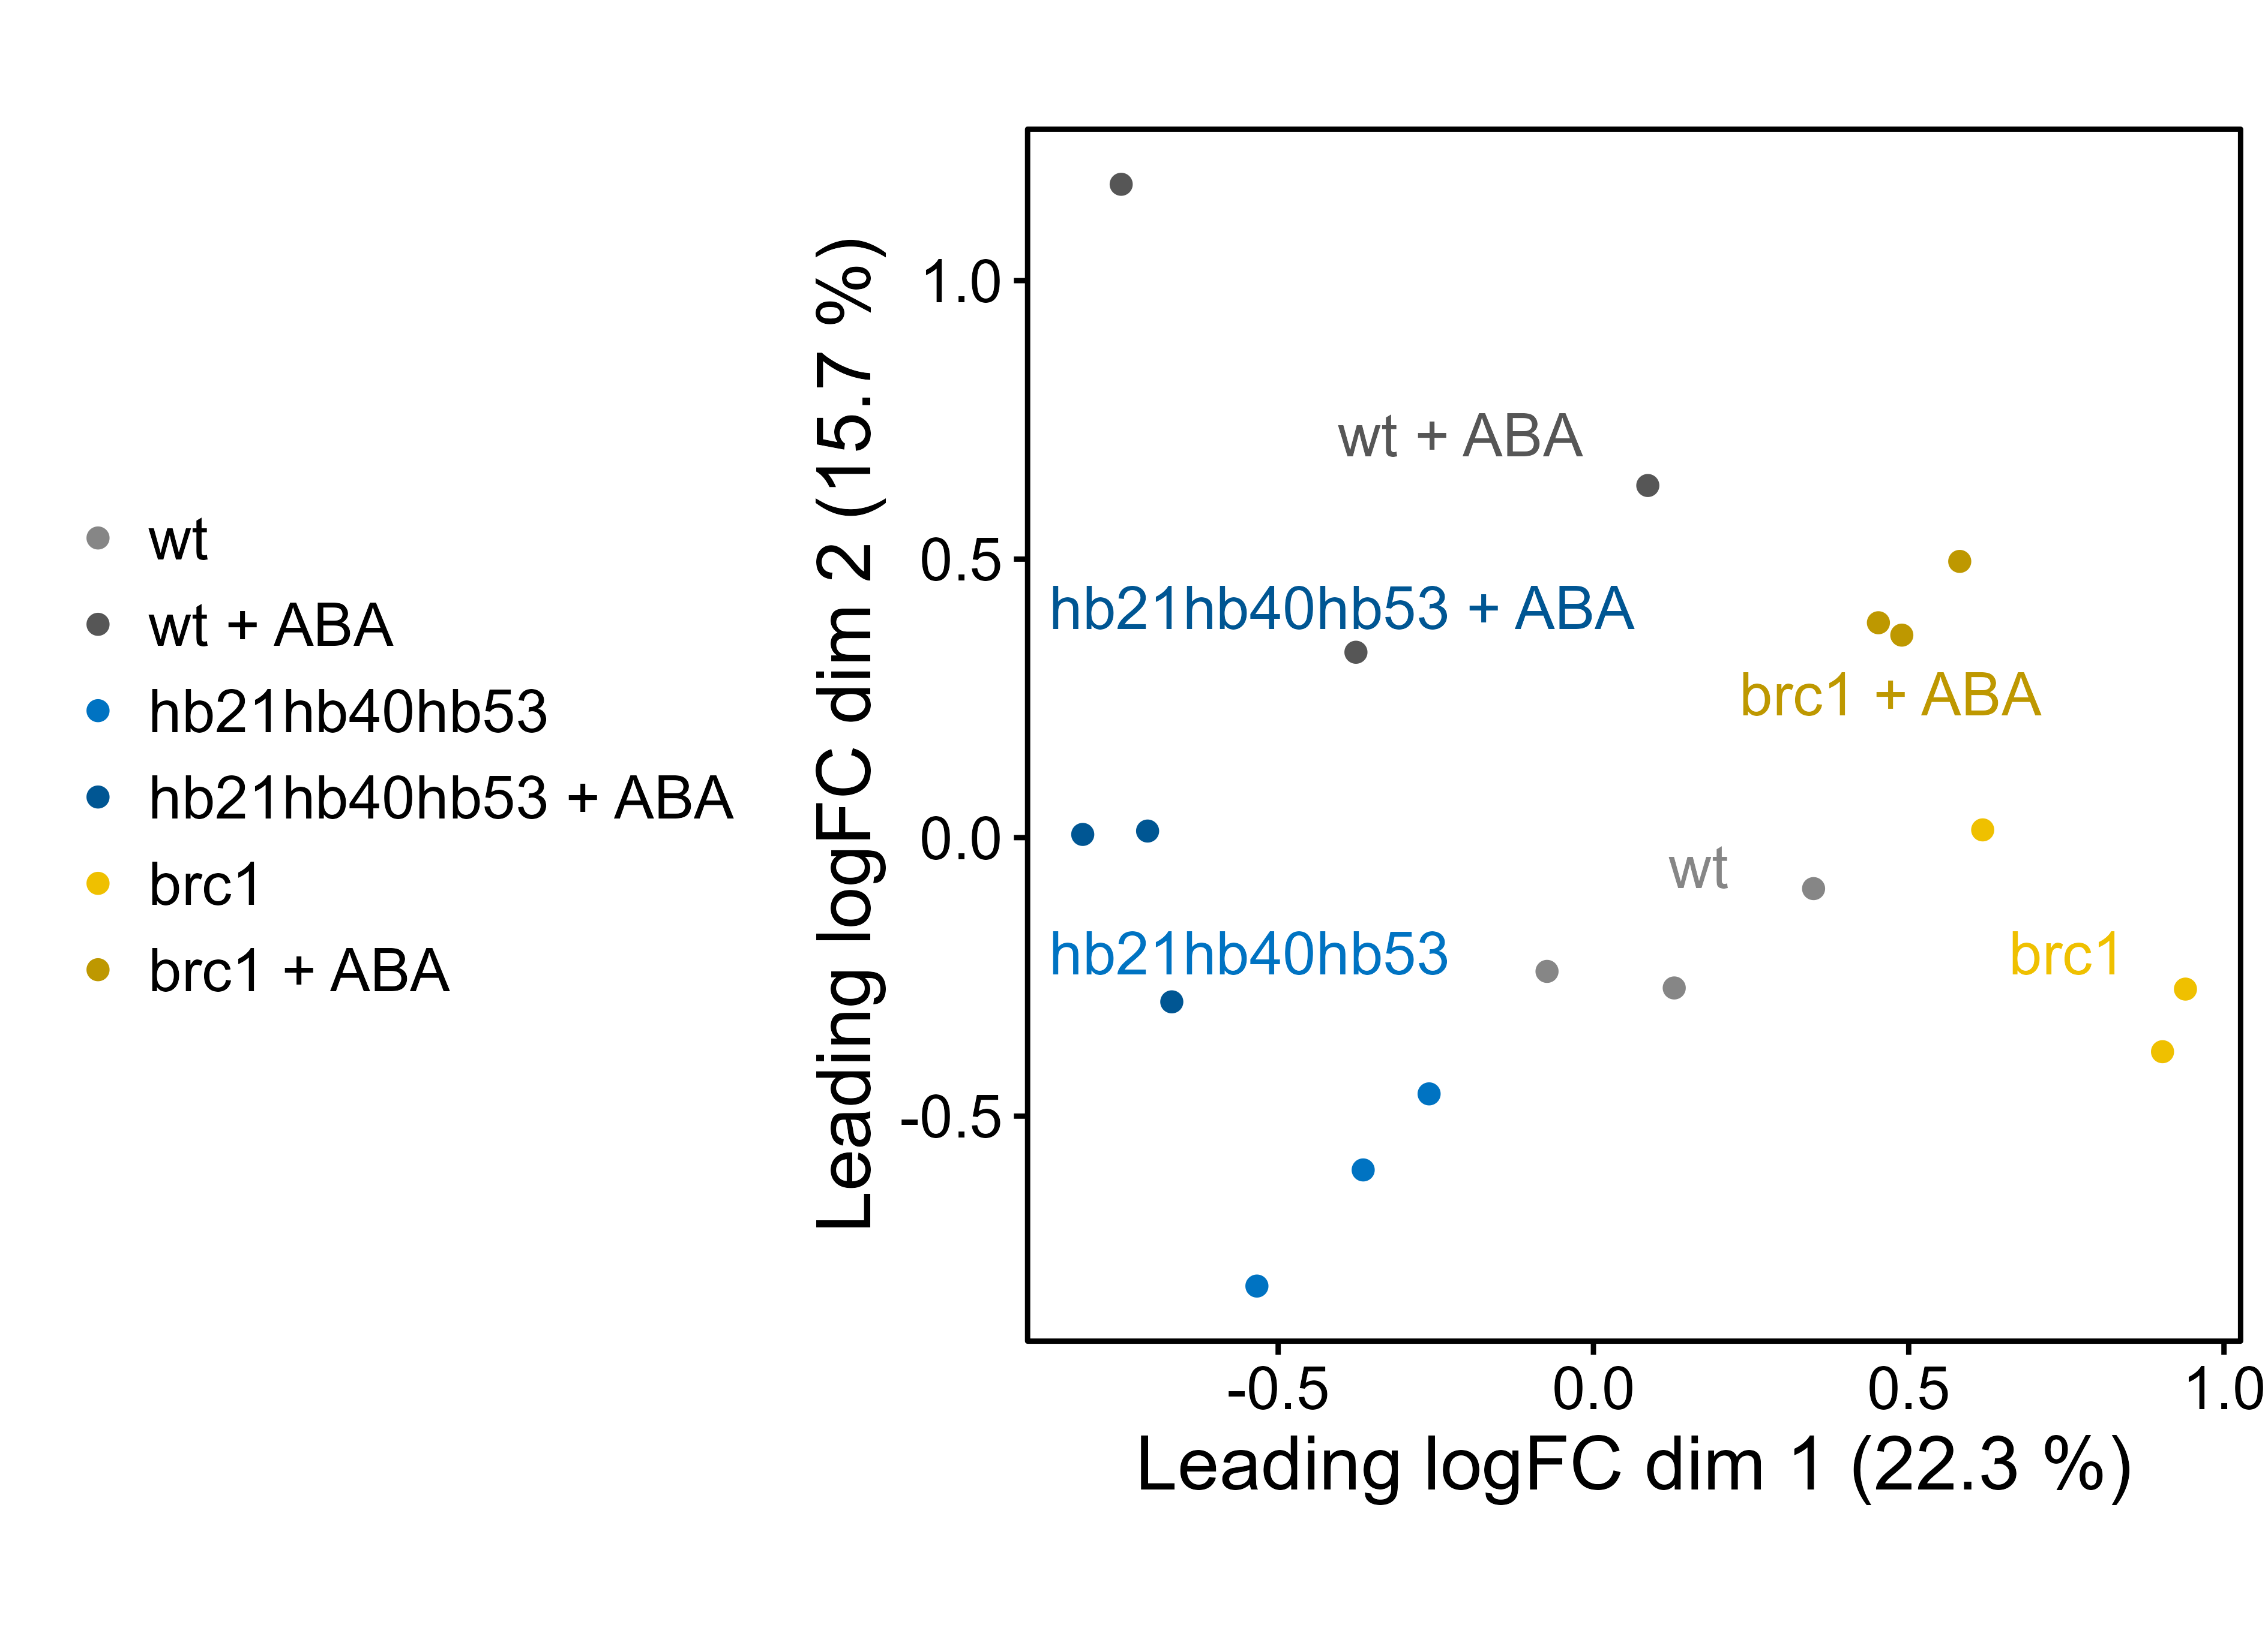

Slide 9
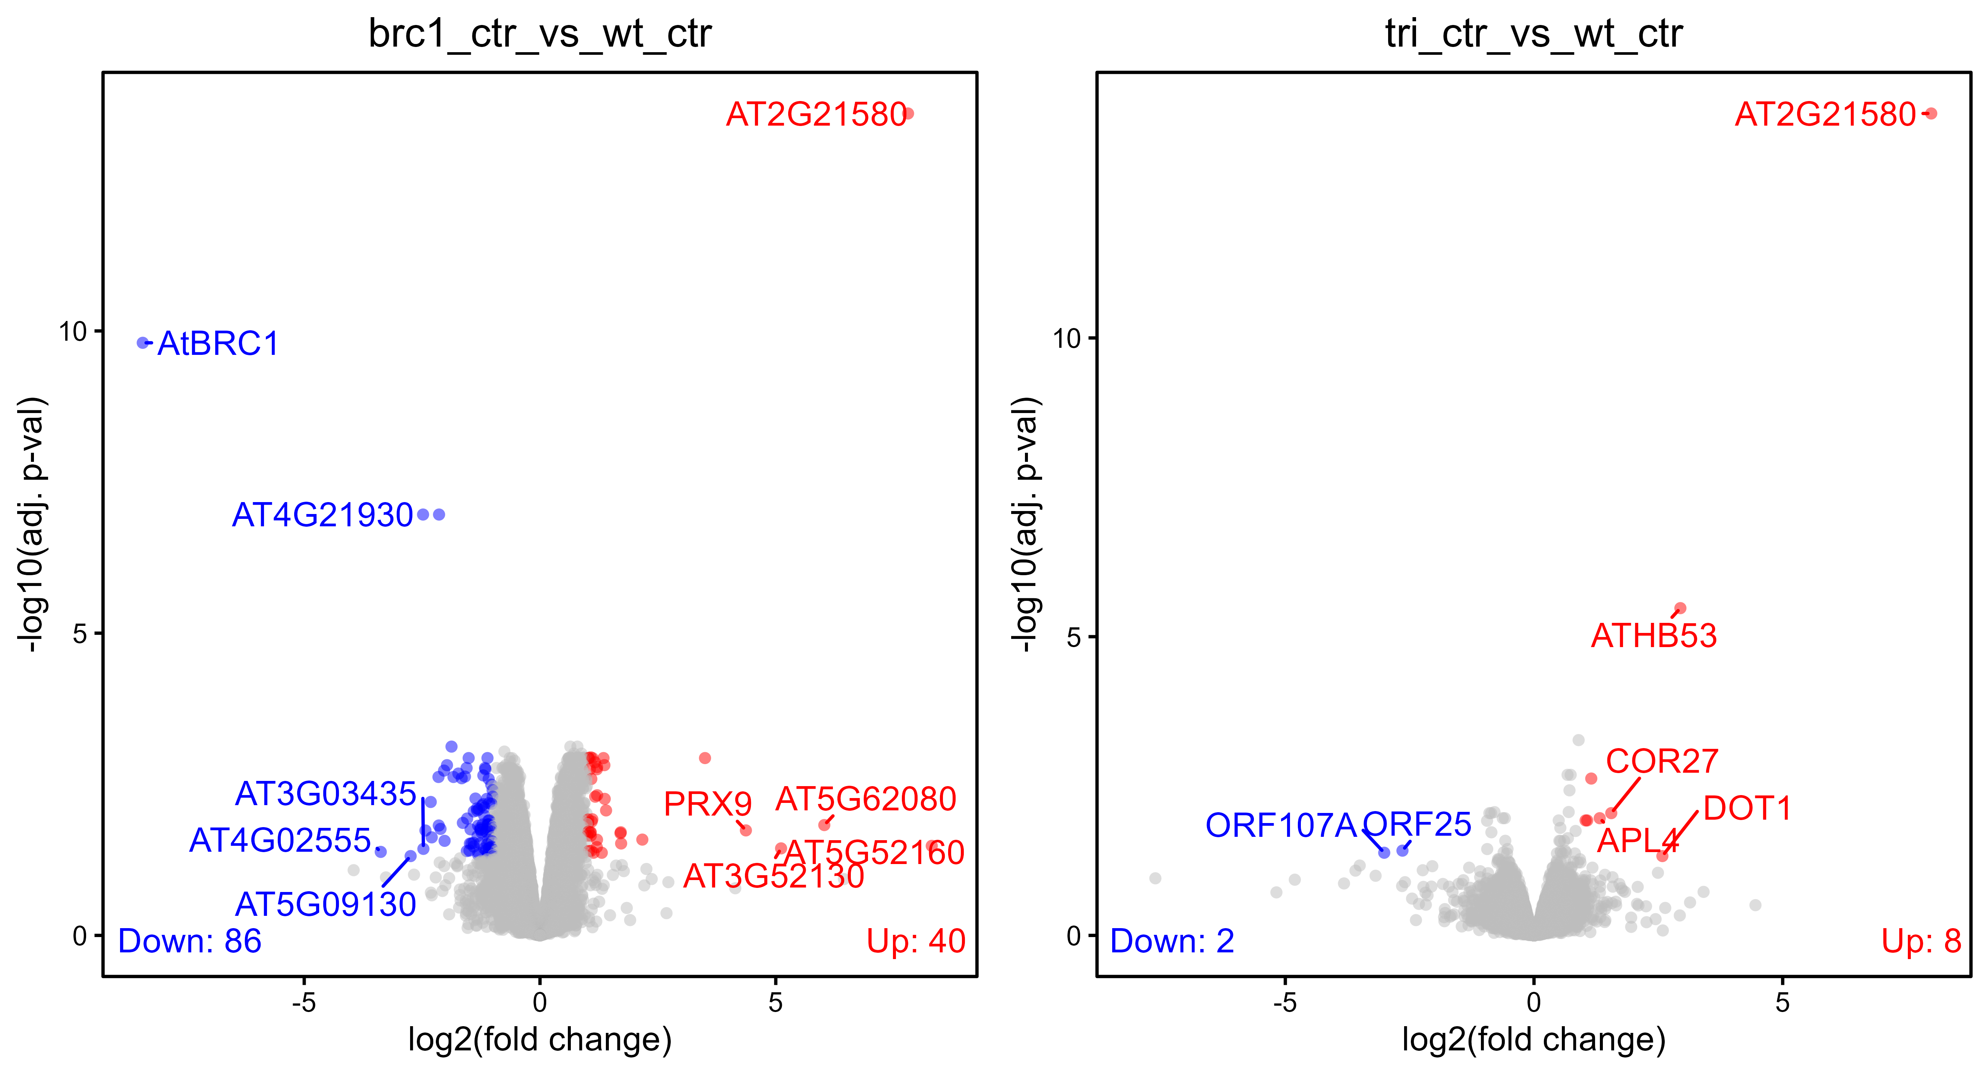
Quality check and data exploration (ABA experiment)

Slide 10
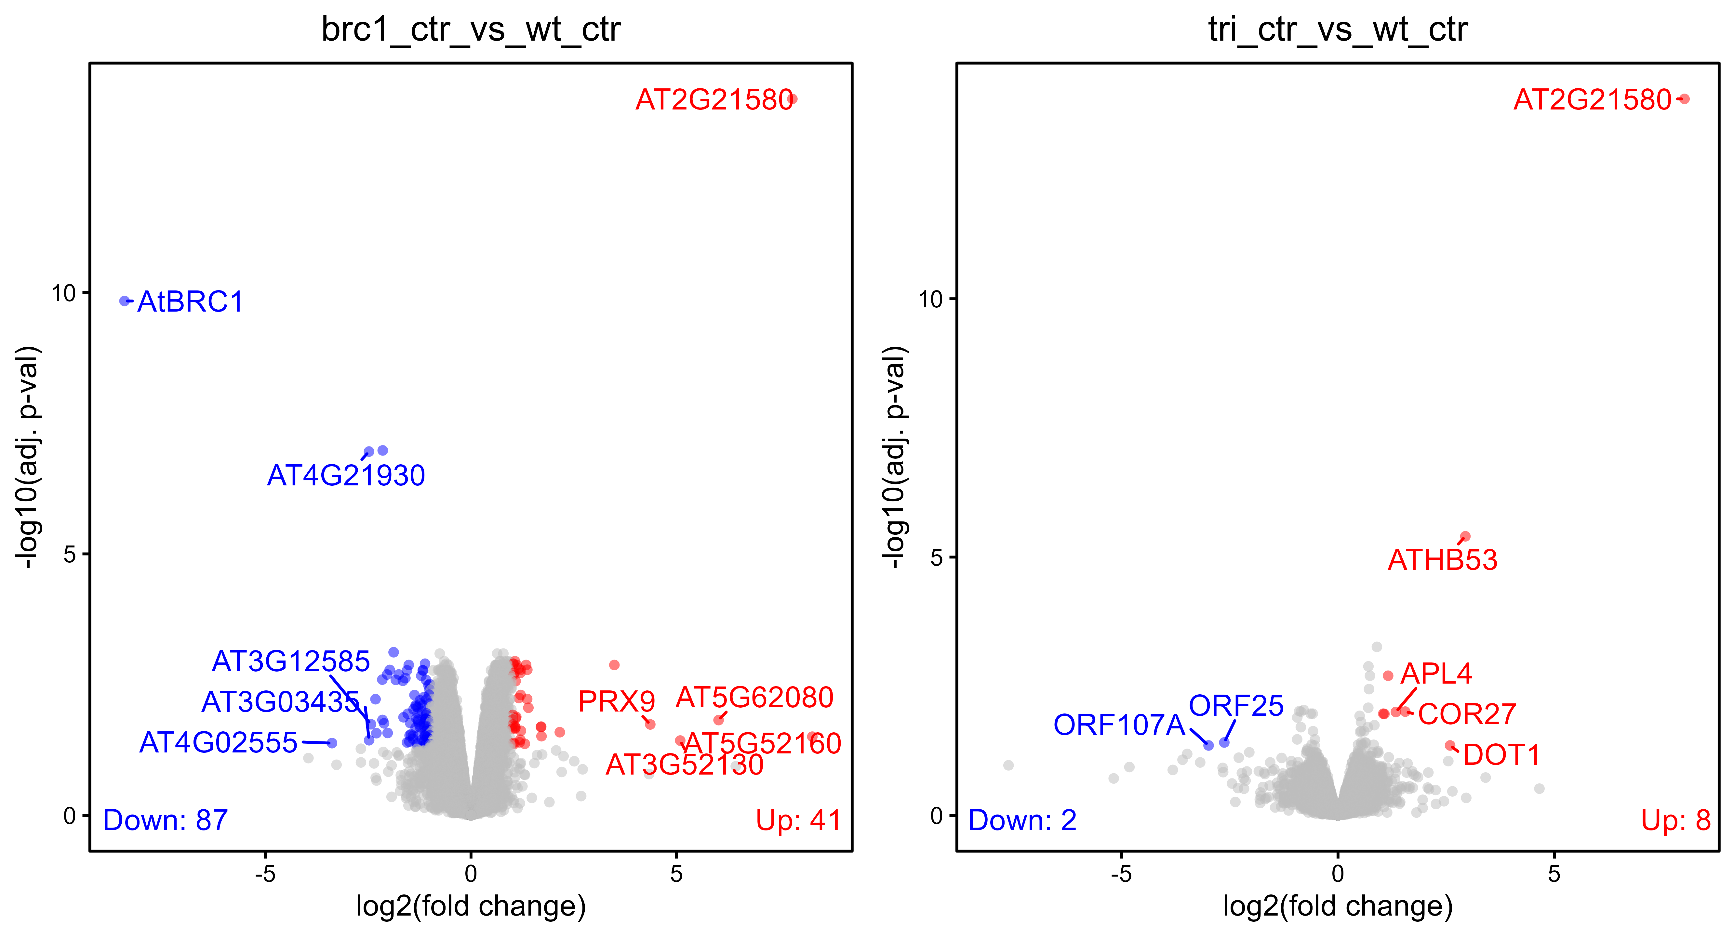

Slide 11
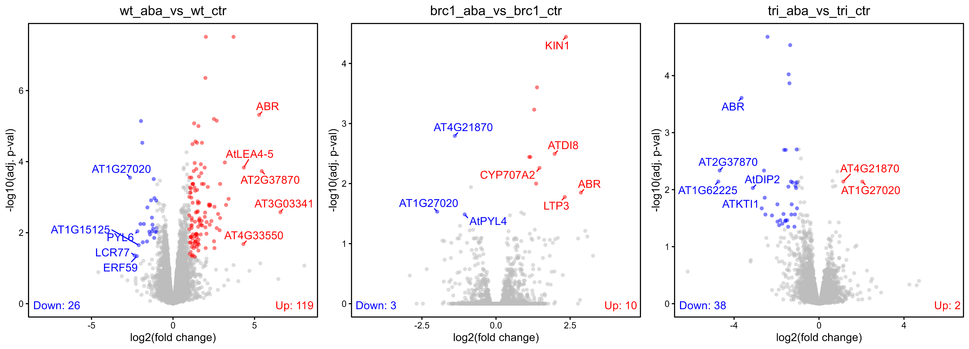
Quality check and data exploration (ABA experiment)

Slide 12
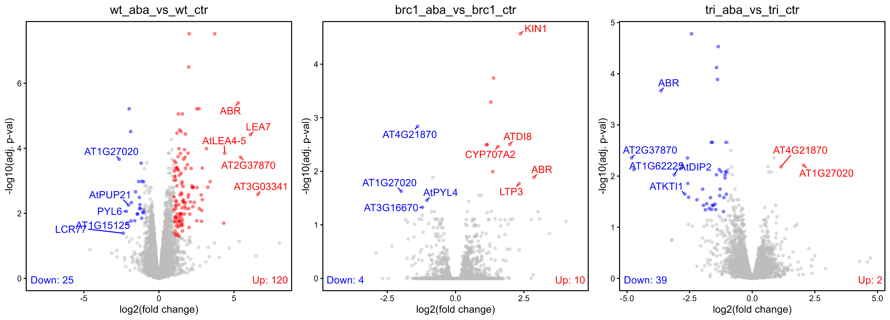

Slide 13
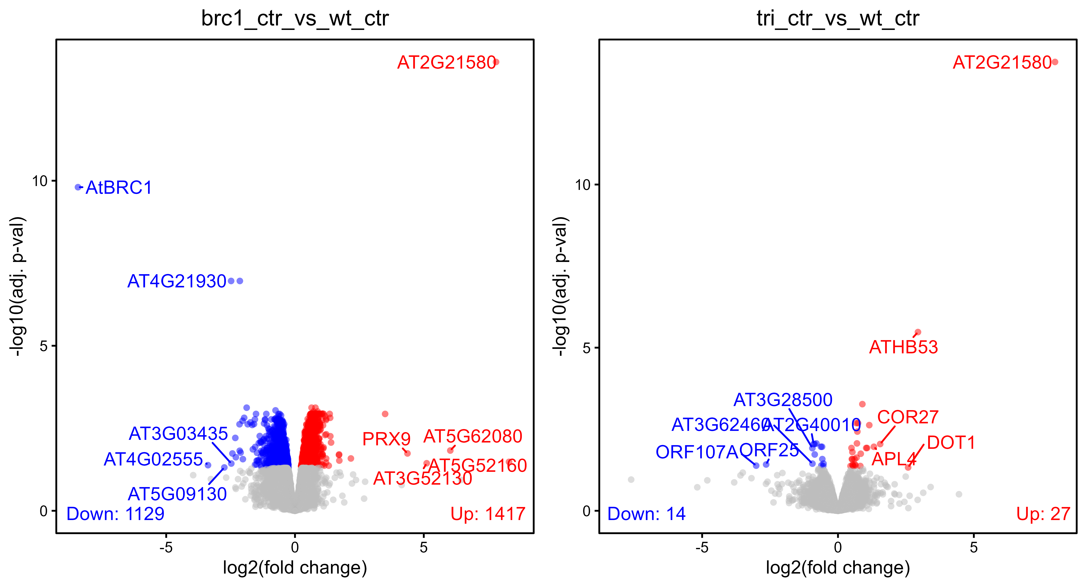
Quality check and data exploration (ABA experiment – no FC threshold)

Slide 14
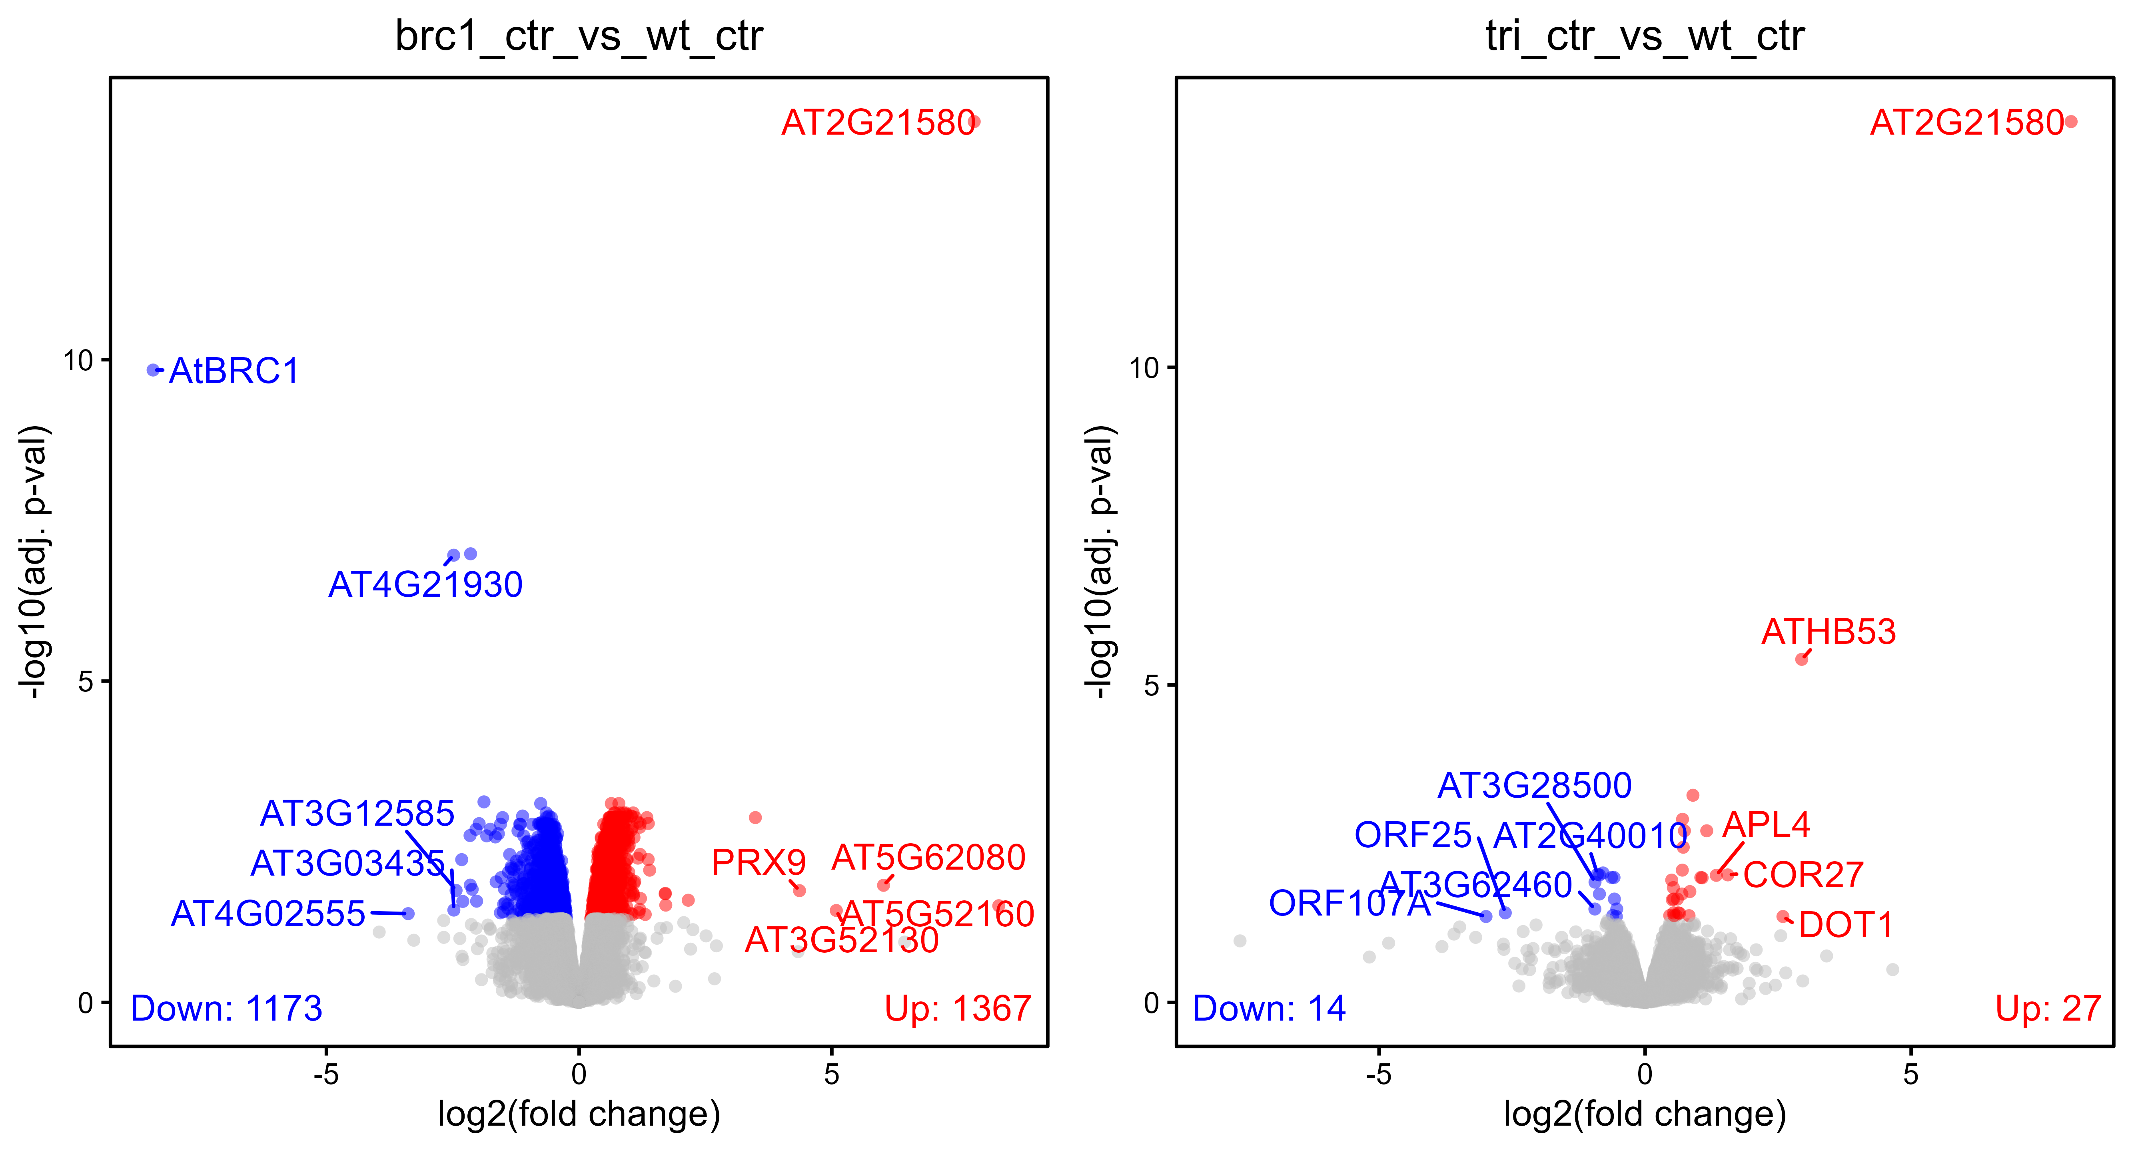

Slide 15
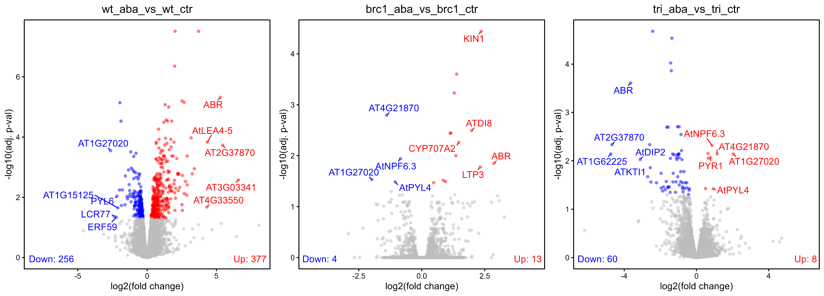
Quality check and data exploration (ABA experiment – no FC threshold)

Slide 16
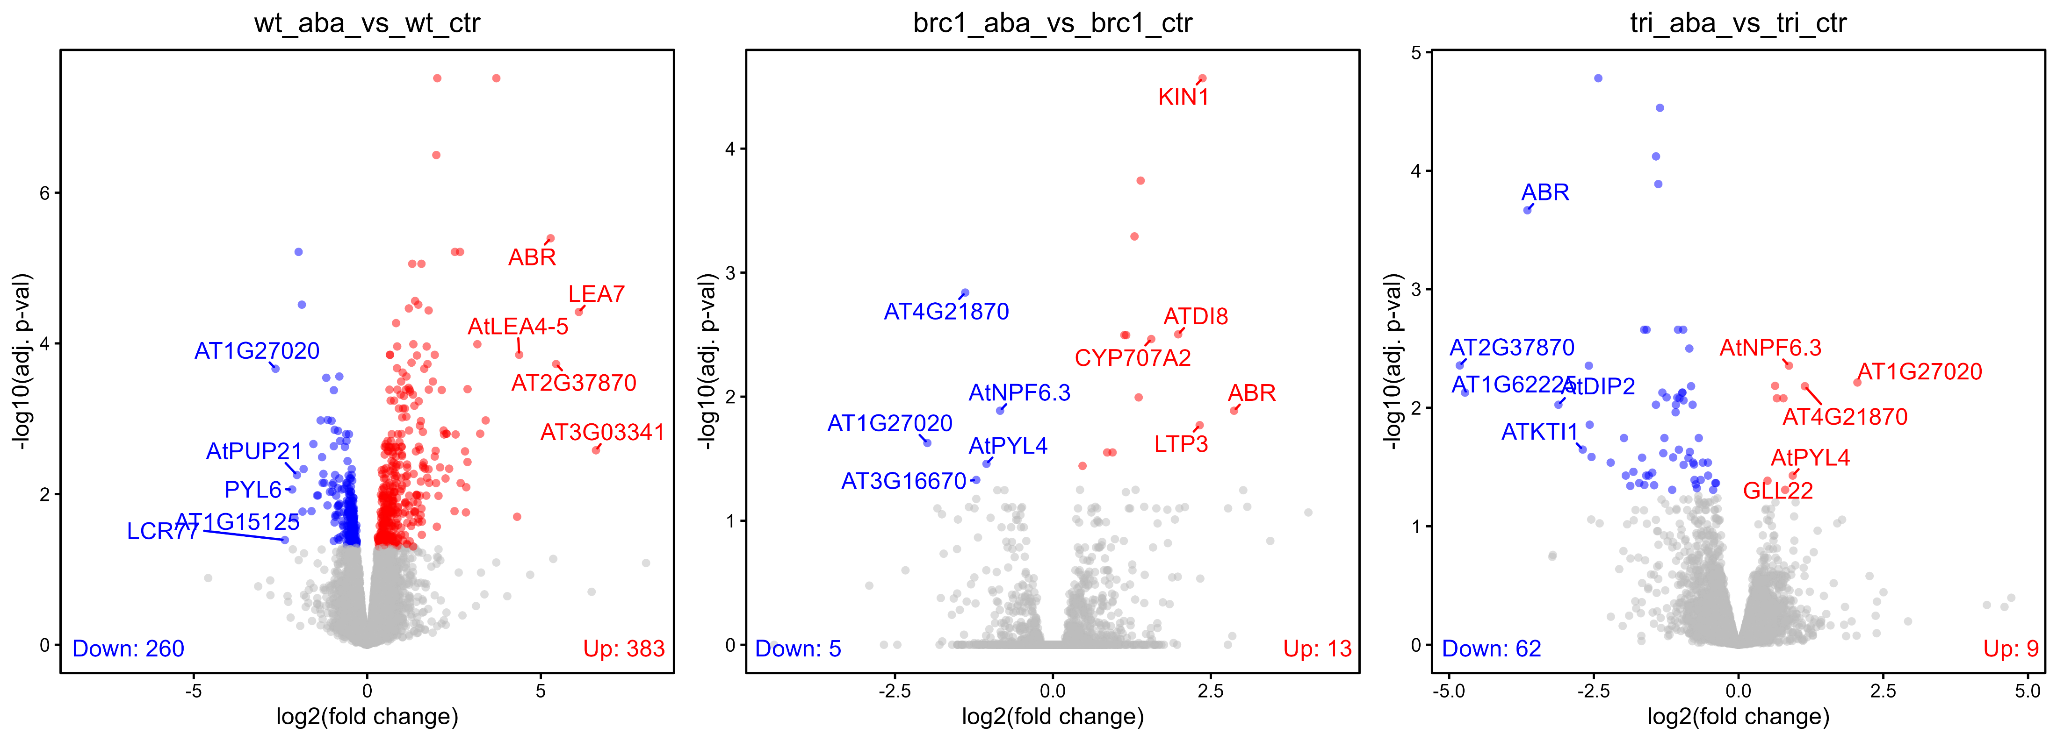

Slide 17
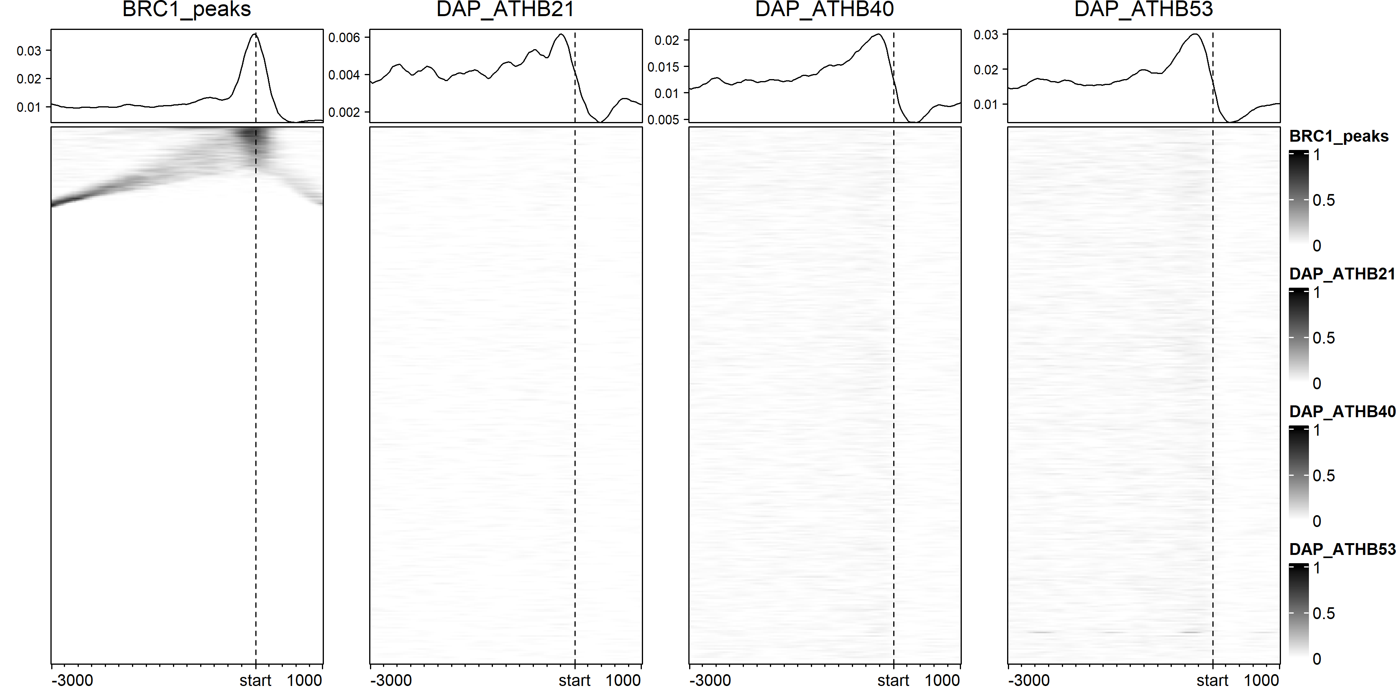
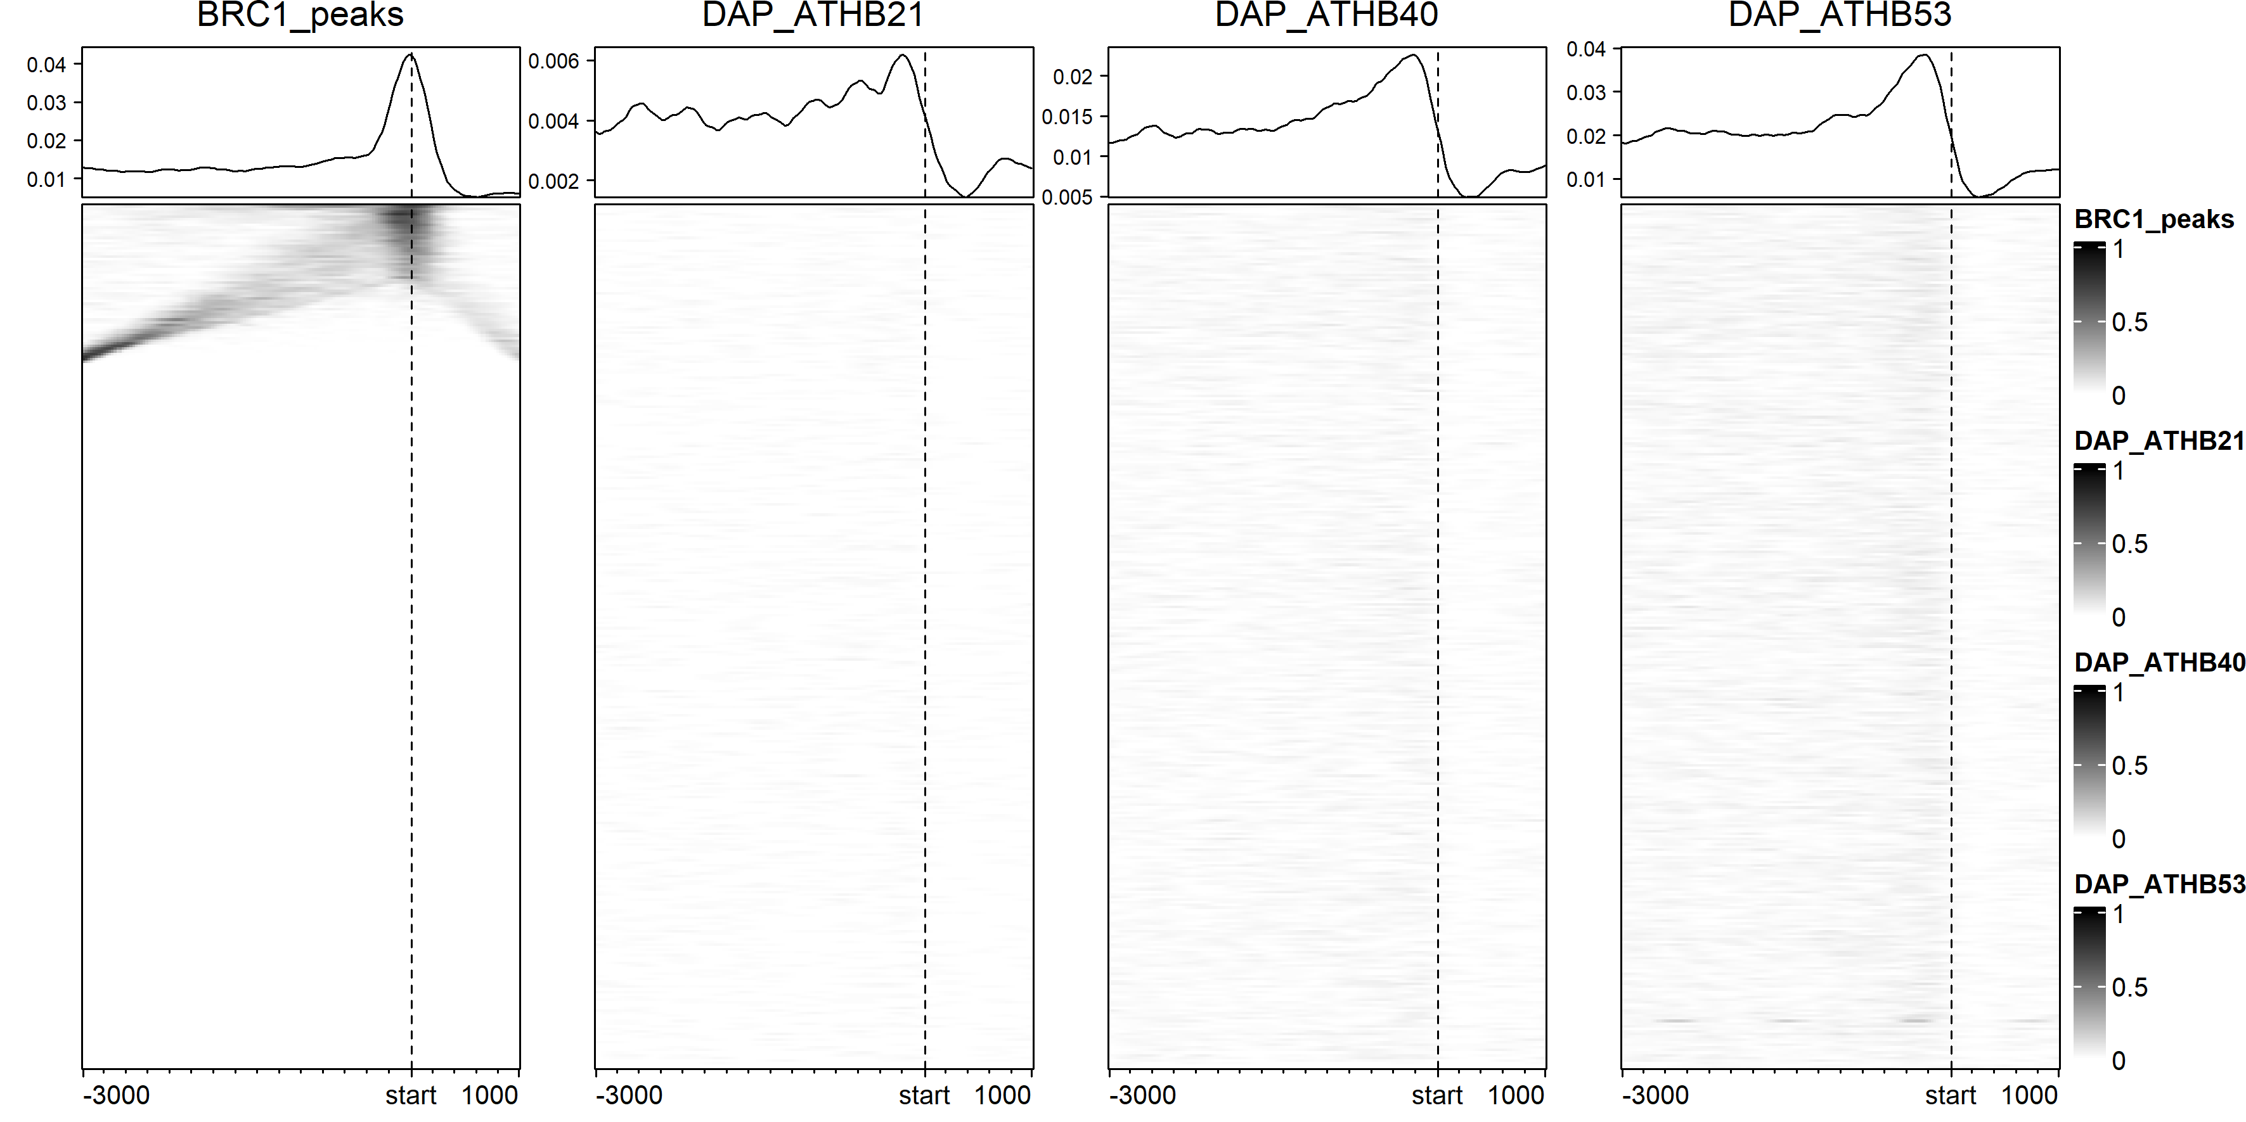

Slide 18
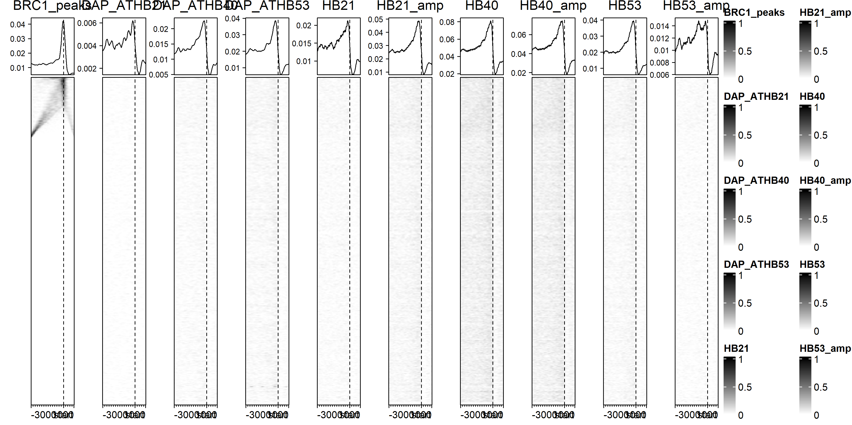

Slide 19
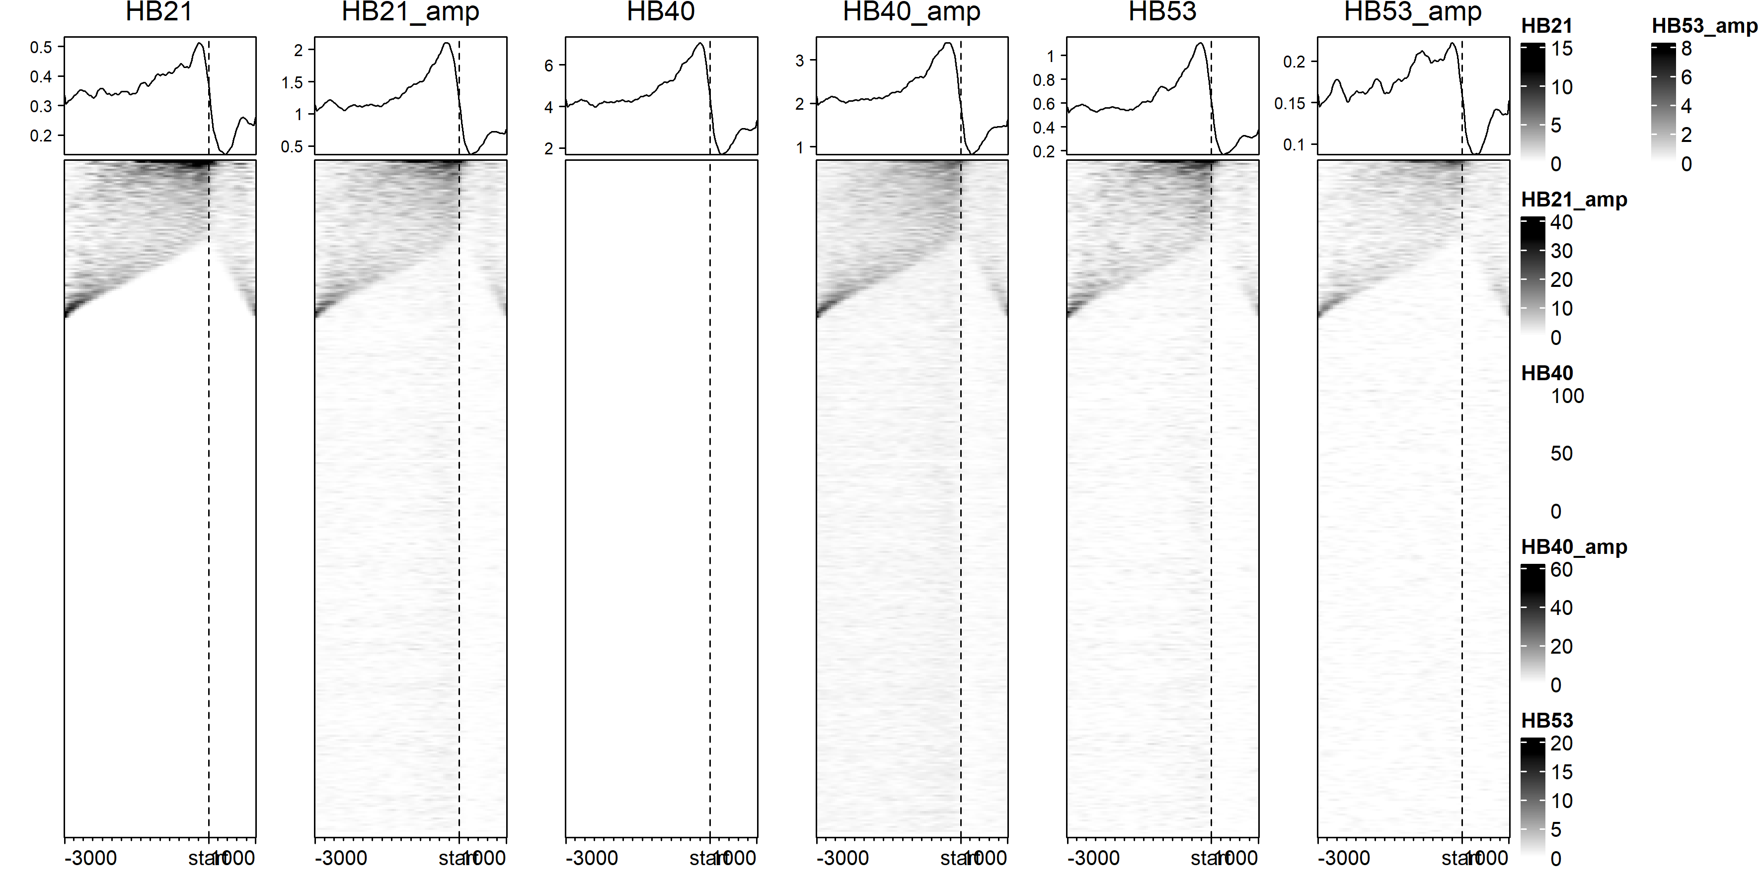

Slide 20
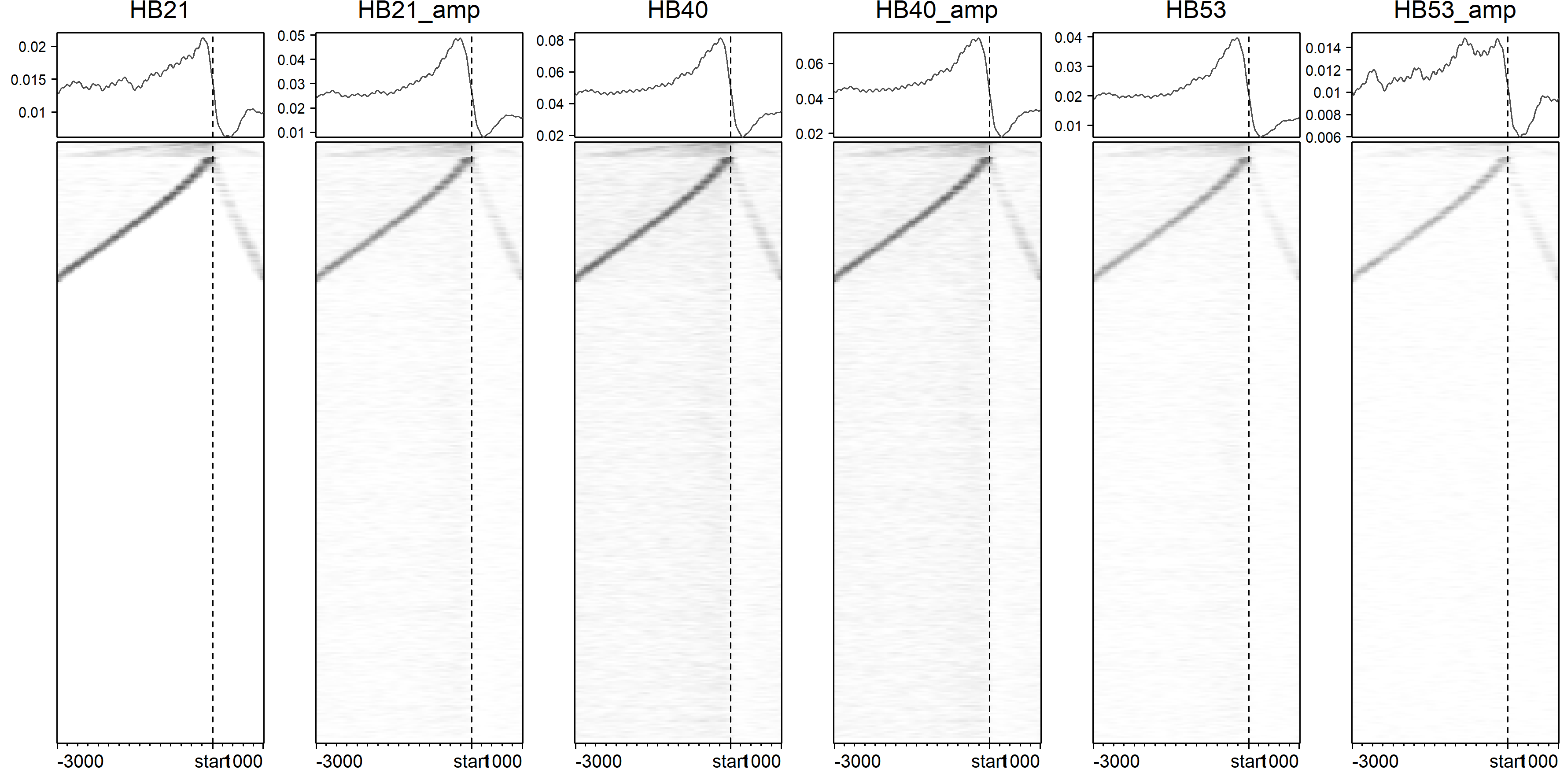

Slide 21
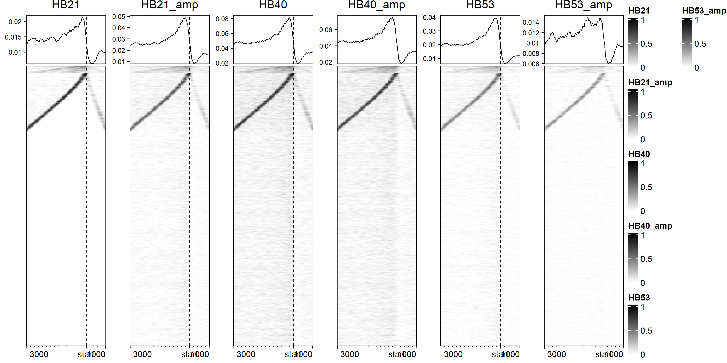

Slide 22
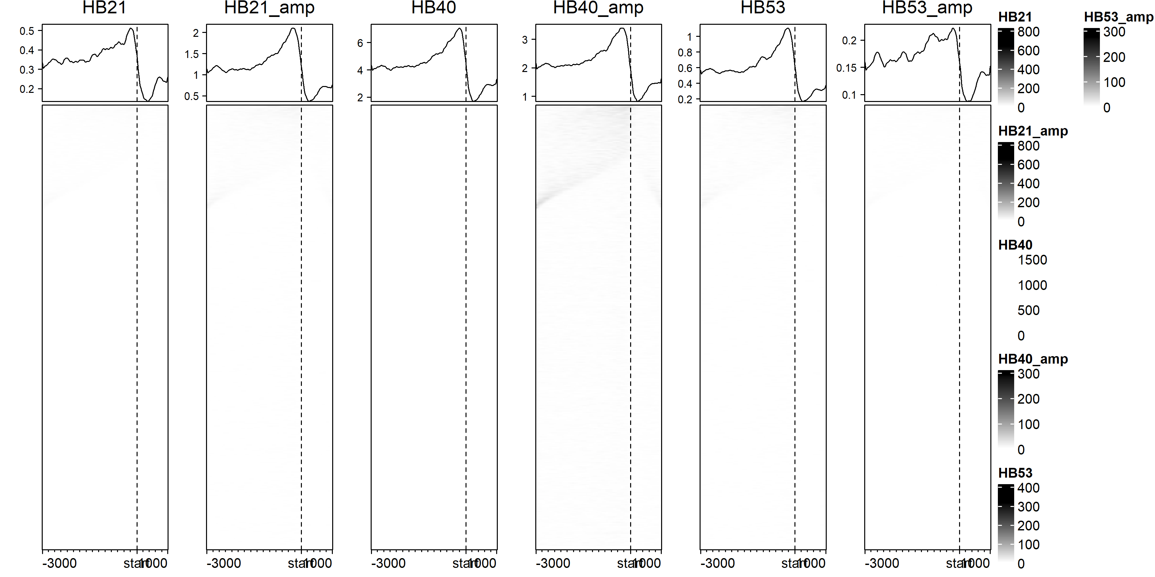

Slide 24
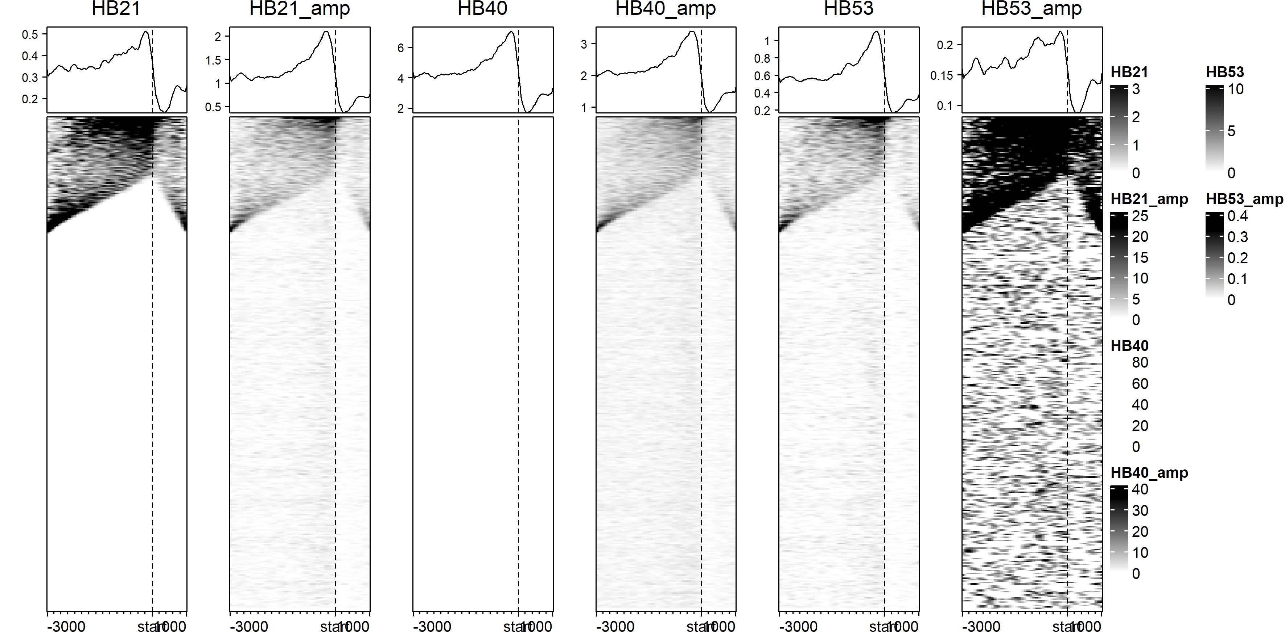

Slide 25
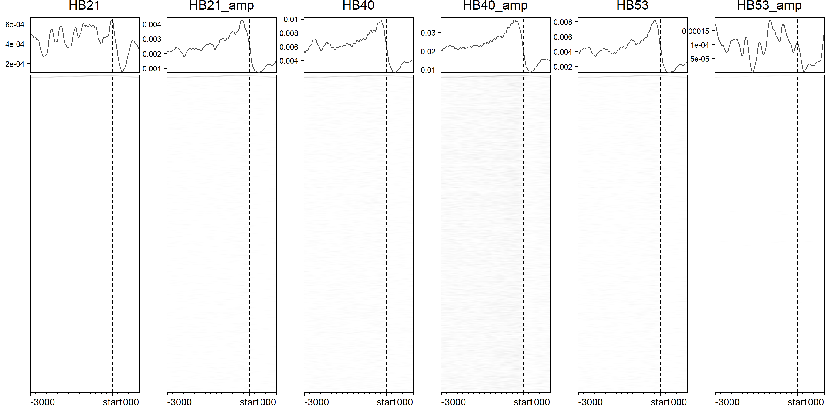
Peaks with score >200

Slide 26
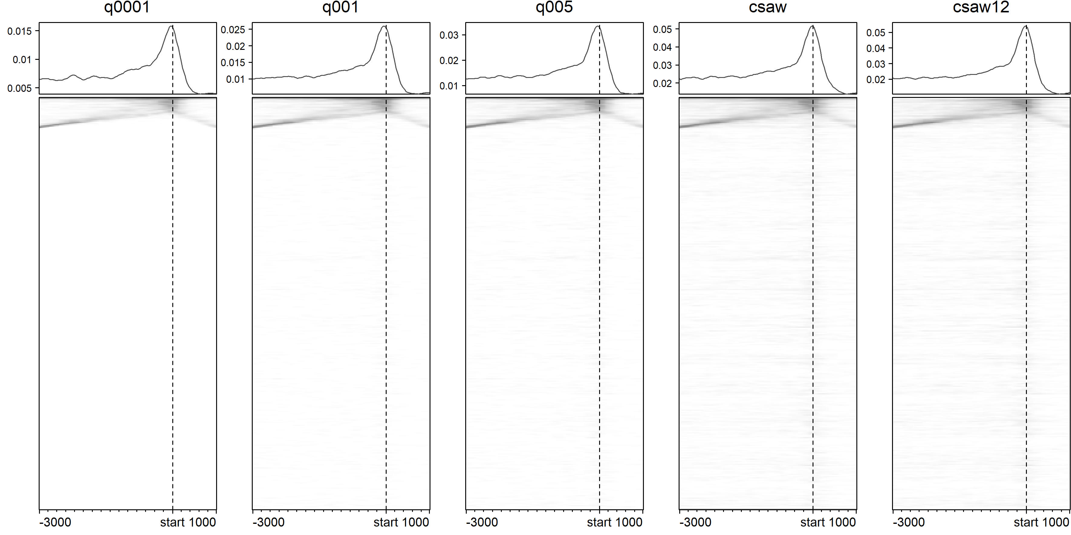

Slide 27
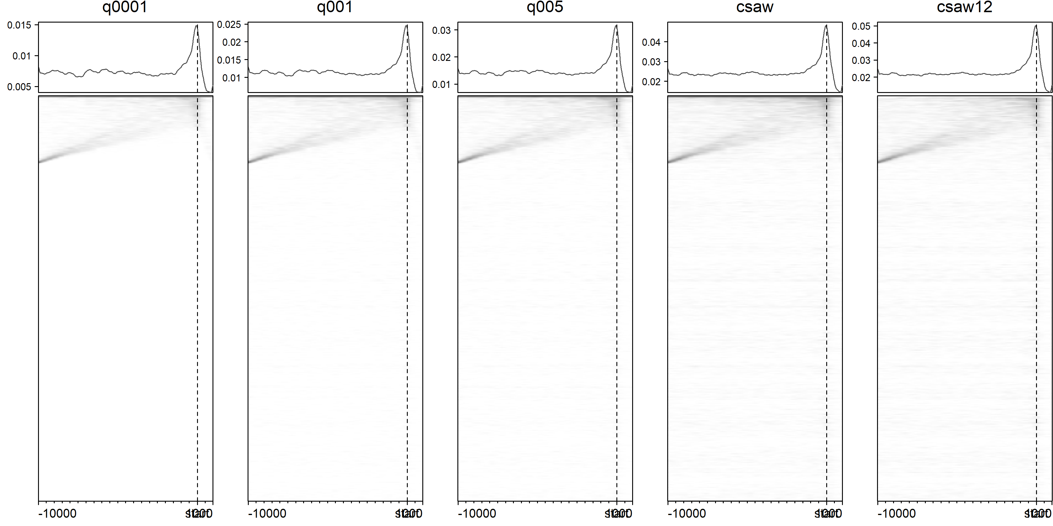

Slide 28
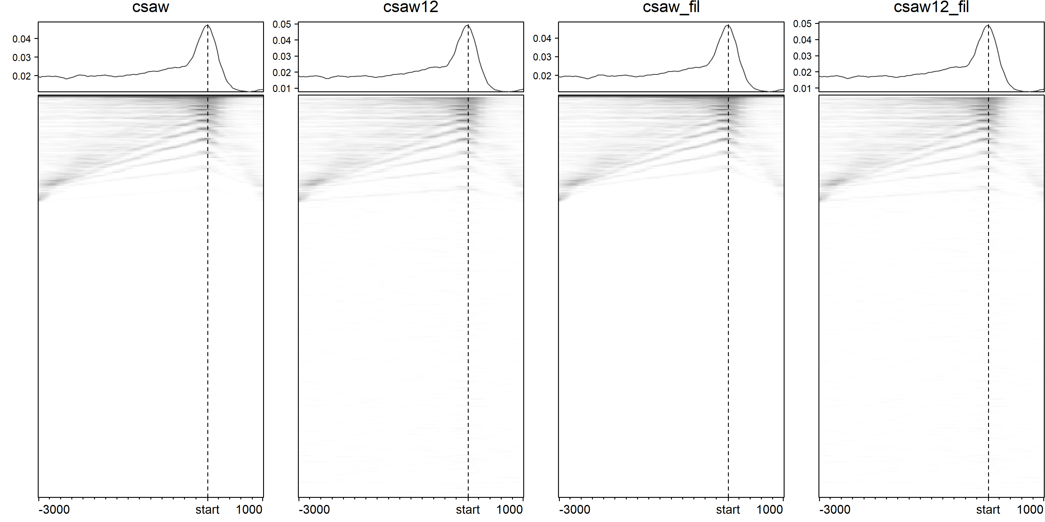
Filtered peaks of 10 bp length

Slide 29
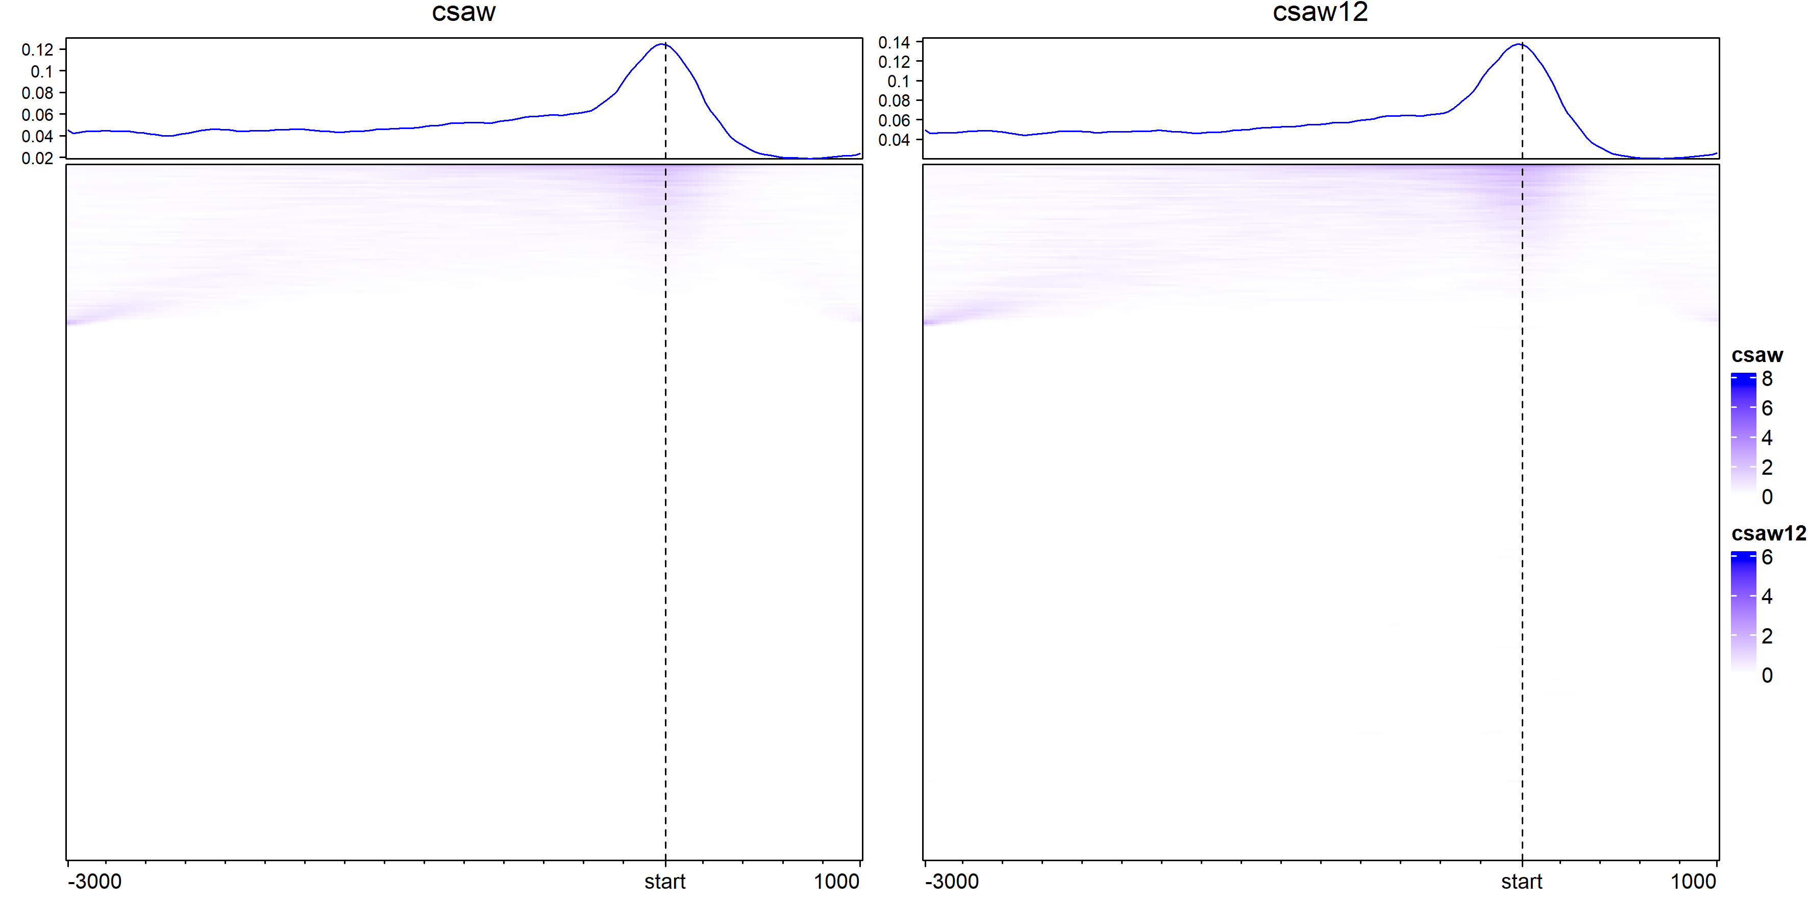
Peak signal

Slide 30
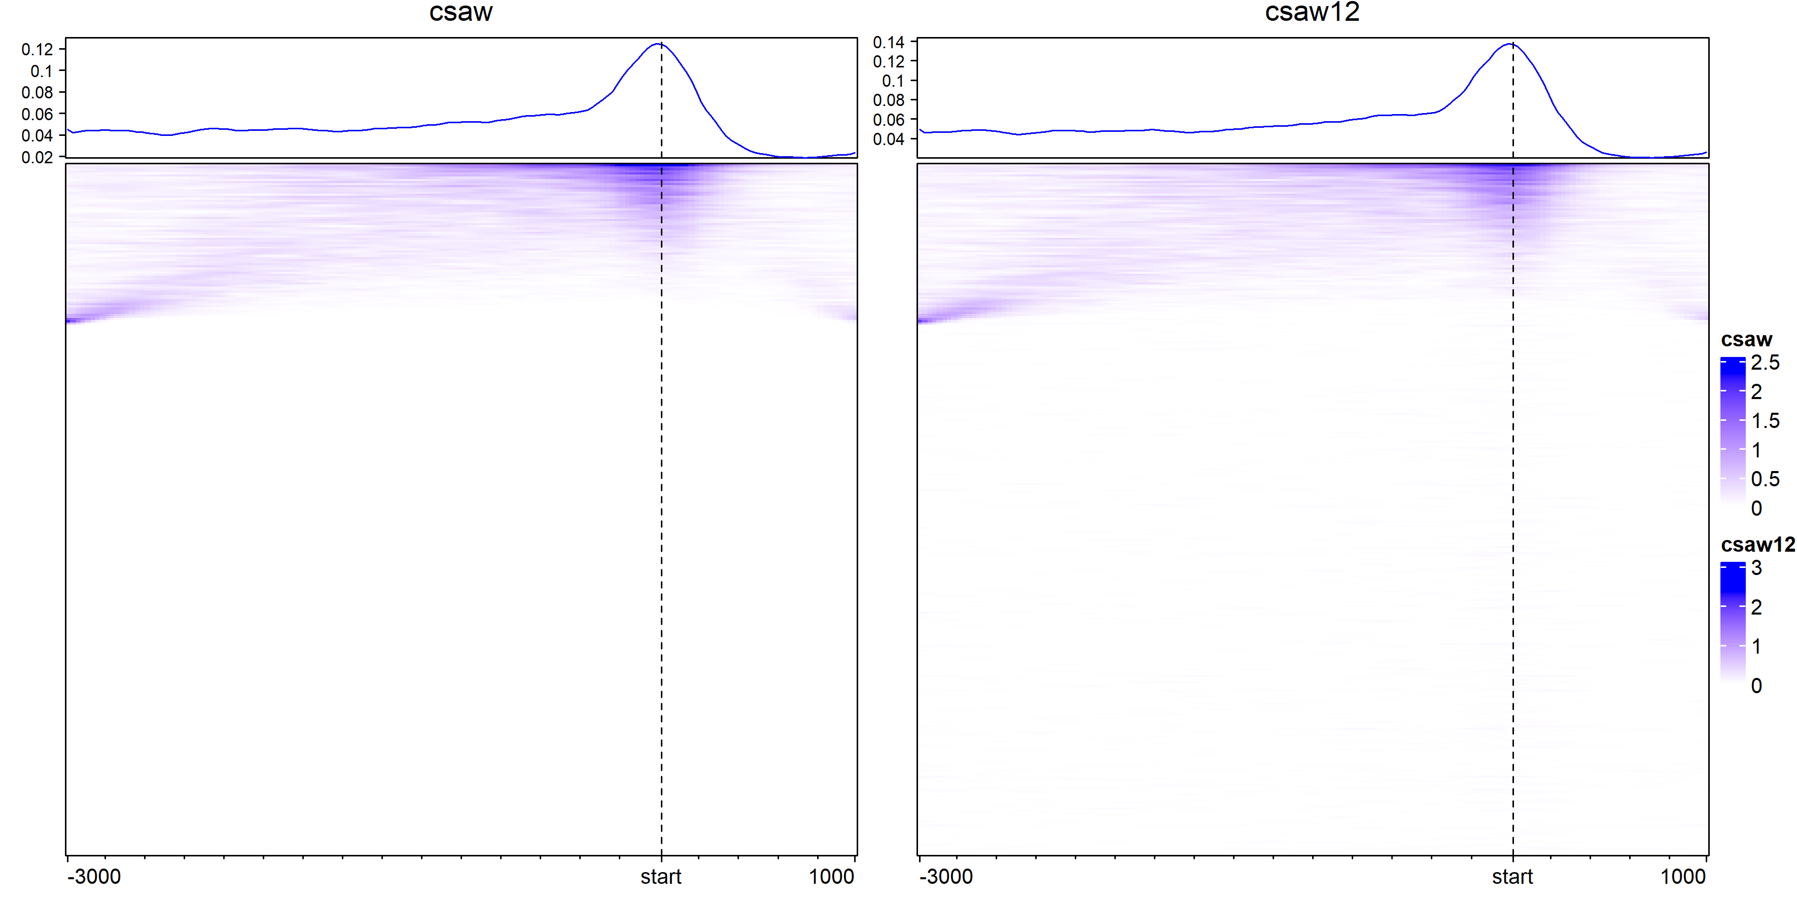
Peak signal with adjusted color scale to top 99% values

Slide 31
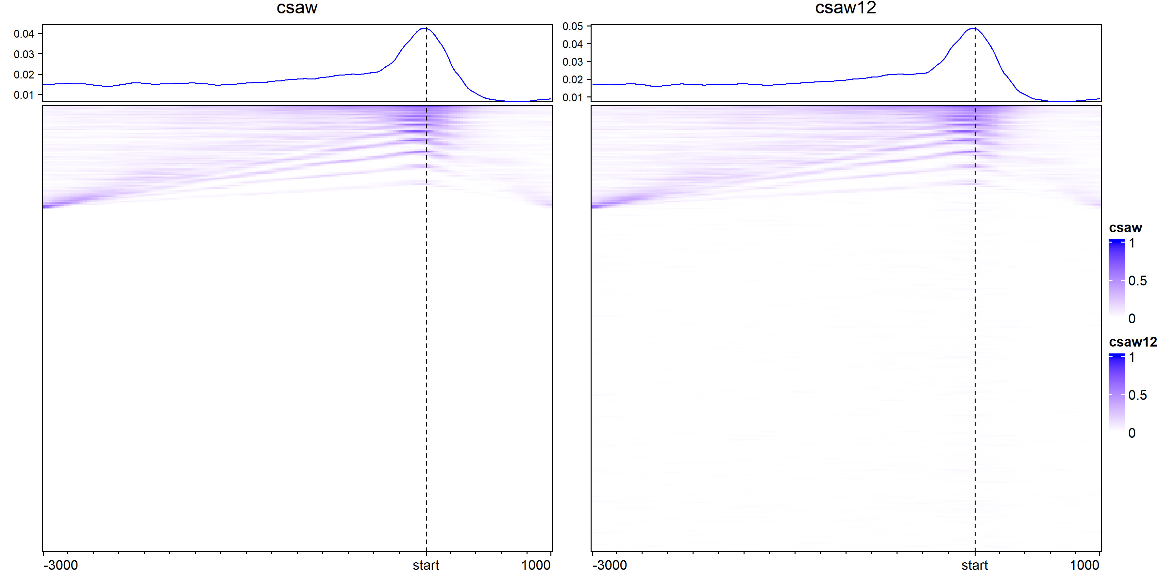
Only peak location reported

Slide 32
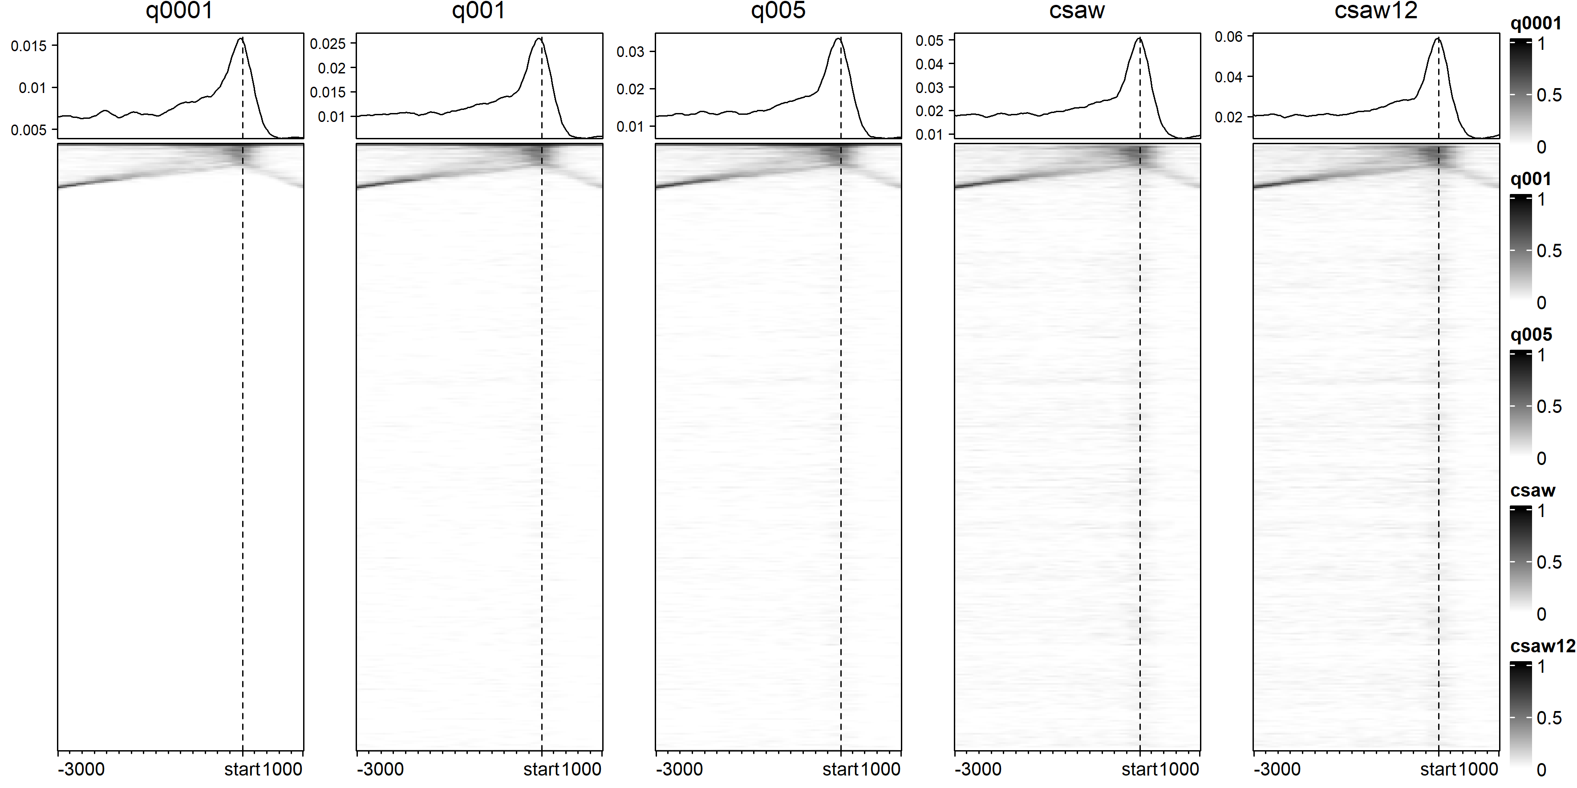

Slide 33
